Slide 1


44.04.01. Pedagogical Education
History education specialization
Programme leader: Doctor of History, Professor, Department of General and National History, EI KFU
Inga Maslova

Slide 2

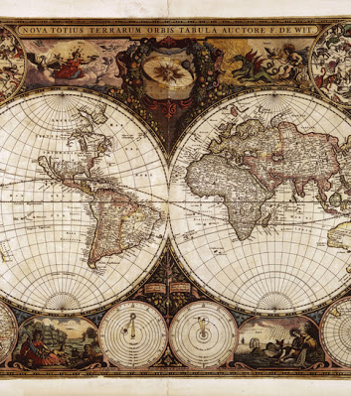
Form of study - part-time (2 sessions per year)
Study period - 2 years 6 months
Entrance test - history and pedagogy test

Slide 3
The mission of the History Education Masters Programme is to form the intellectual elite of contemporary Russian society in the context of the increasing role of patriotic education and the formation of the foundations of civic identity.

Slide 4
The "History Education" profile focuses on the in-depth study of historical disciplines, theory and methods of teaching history, the acquisition of skills in scientific historical research, meeting the requirements of professional standards and the current state of the labour market in the field of educational services of the Russian Federation.

Slide 5
By choosing the History Education profile you have the opportunity to advance your career and work successfully in related fields in the "people to people" field - in human resources management, in training centres of state and commercial enterprises, in consultancy, recruitment agencies.

Slide 6
10 popular careers for graduates of Master's in History Education

Slide 7

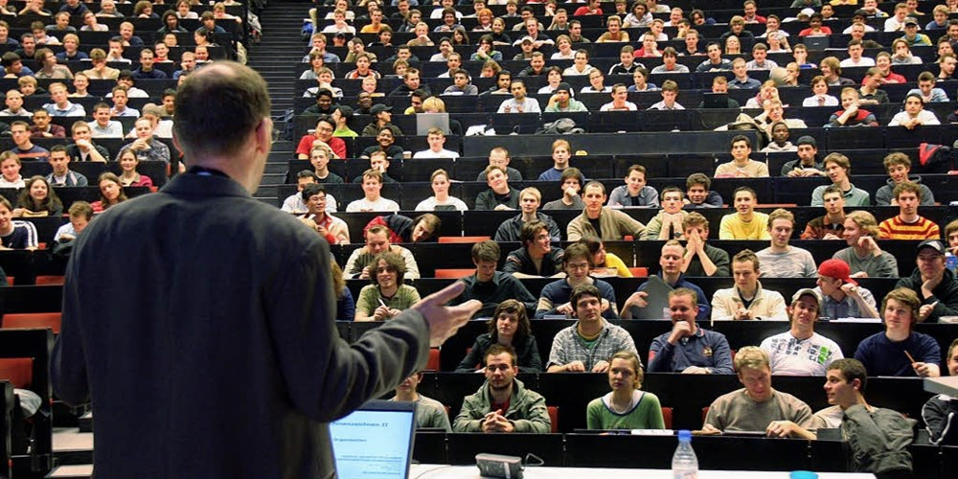
History teacher in school, technical school, college
History teacher at a university

Slide 8
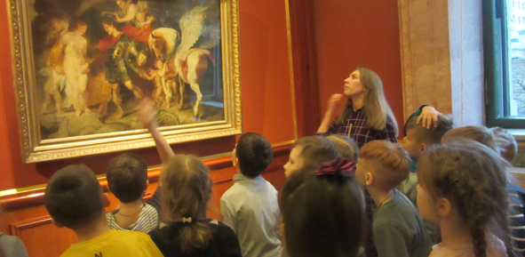
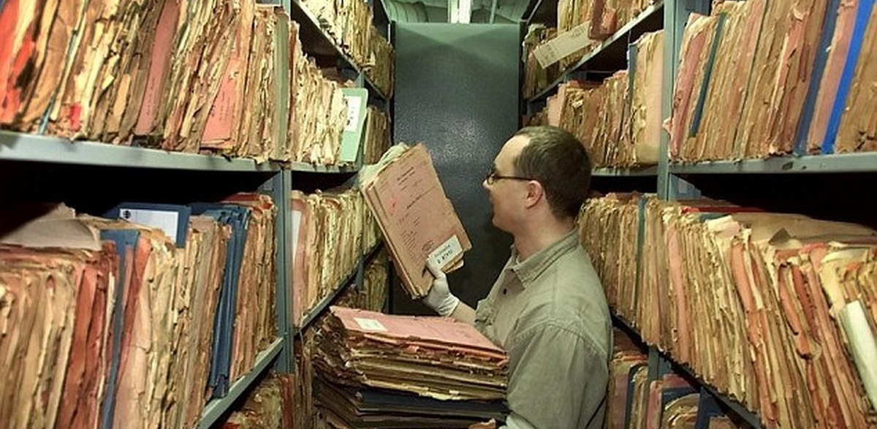
Museum employee, archivist

Slide 9


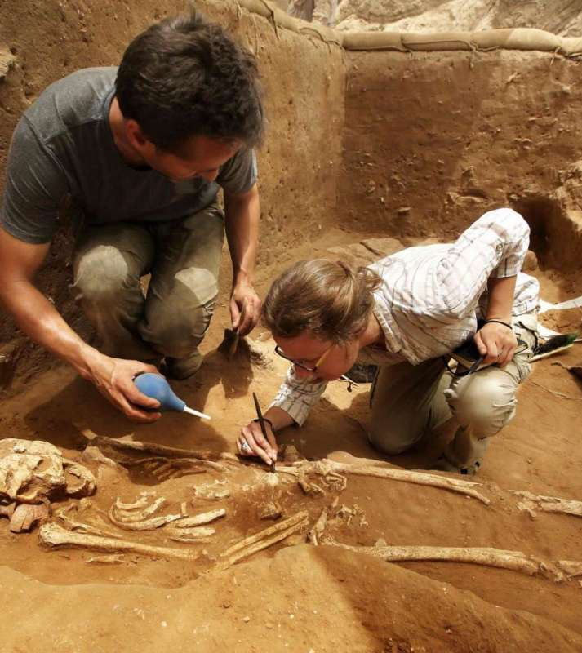
Archaeologist
Librarian

Slide 10




Tourism Development Manager
Specialist in the tourism industry

Slide 11

You have a opportunity to postgraduate school and pursue a career in science

Slide 12


If you have decided to pursue higher education as a Bachelor's graduate, go all the way, do not stop at the first level. Apply for a Master's degree!

