Slide 1
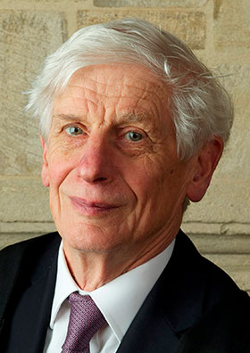
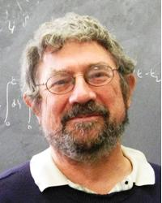
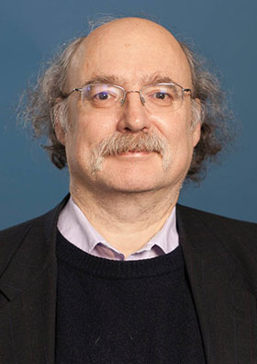
Nobelpreis 2016 in Physik: Topologie, Exotische Physik und Phasenübergänge im Flachland
David J. Thouless
@ University of Washington, Seattle
J. Michael Kosterlitz
@ Brown University
F. Duncan M. Haldane @ Princeton University
1/2
1/2
KFU, 19.05.2017

Slide 2
Outline
Prize motivation:
"for theoretical discoveries of topological phase transitions and topological phases of matter"
Band theory of solids and Quantum Hall Effect
Berezinskii-Kosterlitz-Thouless phase transition
Non-trivial topology of the Haldane spin chain
KFU, 19.05.2017

Slide 3
Outline
Prize motivation:
"for theoretical discoveries of topological phase transitions and topological phases of matter"
Band theory of solids and Quantum Hall Effect
Berezinskii-Kosterlitz-Thouless phase transition
Non-trivial topology of the Haldane spin chain
KFU, 19.05.2017

Slide 4
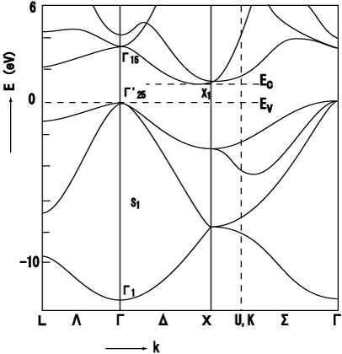
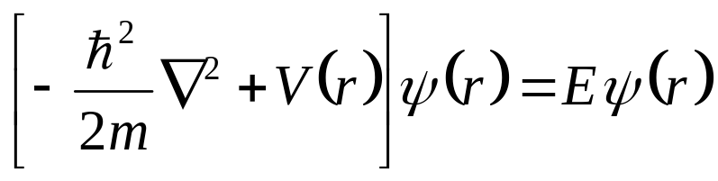

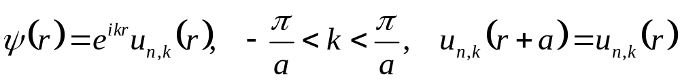


Introduction: band theory of electrons in solids
ion (+ charge)
electron
Periodic electrostatic potential from
ions and other electrons (mean-field)
Schrödinger equation
Bloch’s theorem:
Energy band dispersion
band index
KFU, 19.05.2017

Slide 5


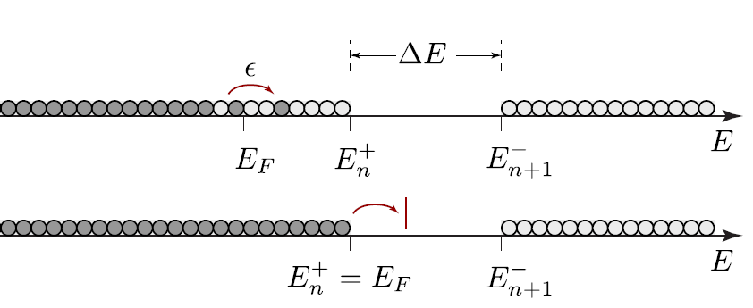


Introduction: band theory of electrons in solids
external perturbation: external electric field, heat source, etc.
- Metal: small amount of energy can be deposited in the system
Insulator: the external energy is not enough to change the state of an insulator
KFU, 19.05.2017

Slide 6
Integer Quantum Hall Effect and band theory
KFU, 19.05.2017

Slide 7
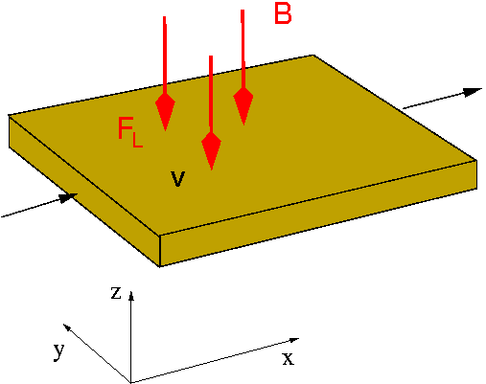

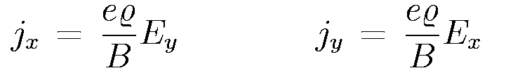
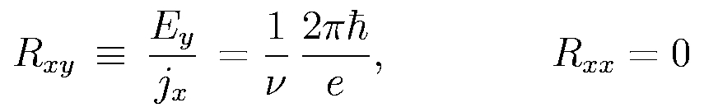
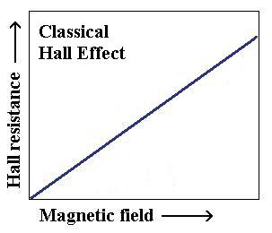
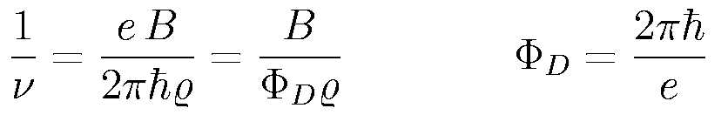
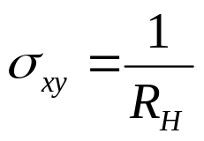
classical Hall effect (1880 E.H. Hall)
Lorentz-force on electron:
stationary current:
Hall resistance:
2
Dirac flux quantum
Hall conductance

Slide 8

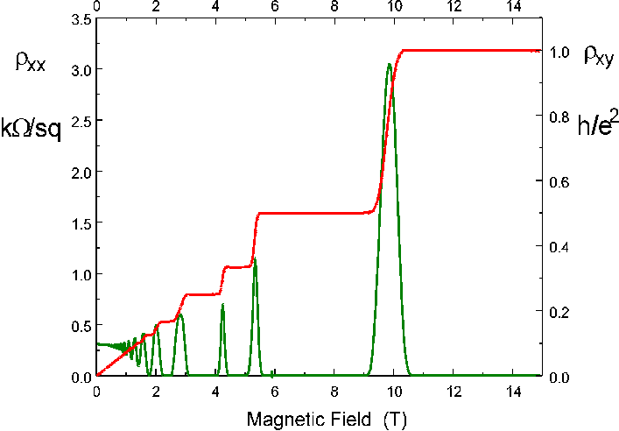
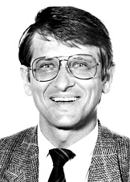
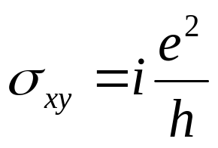
Integer Quantum Hall effect (1980 von Klitzing)
Discovered in 1980, Nobel Prize awarded to von Klitzing in 1985
AlGaAs
GaAs
K. v. Klitzing
Quantization of Hall conductance
exact, robust against disorder and does not depend on the geometry

Slide 9
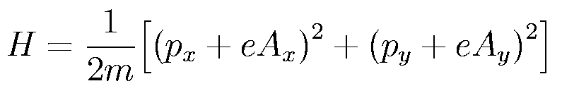
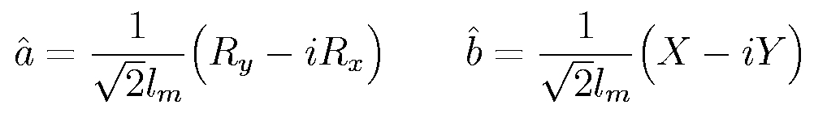
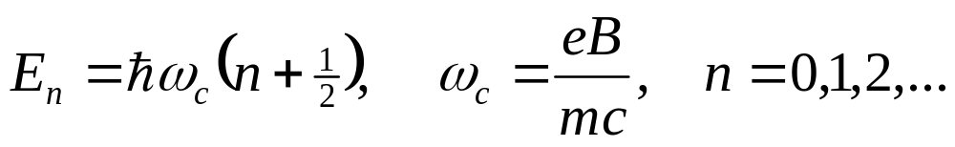
Integer Quantum Hall effect: q-mech description
Electrons are confined in a two-dimensional plane.
(ex. AlGaAs/GaAs interface)
Strong magnetic field is applied
(perpendicular to the plane)
coordinate transformation:
mapping to oscillator:

Slide 10
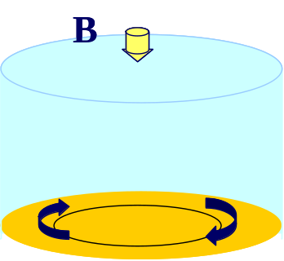
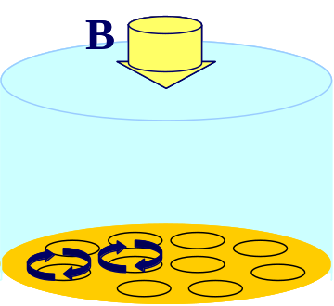
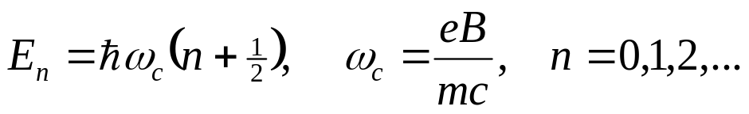
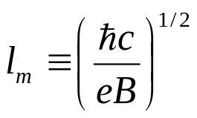
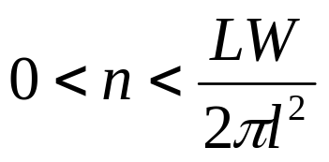
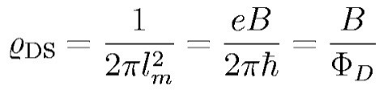
Integer Quantum Hall effect: q-mech description
cyclotron motion
energy
Landau levels:
magnetic length
Energy
DOS:
Increasing B

Slide 11
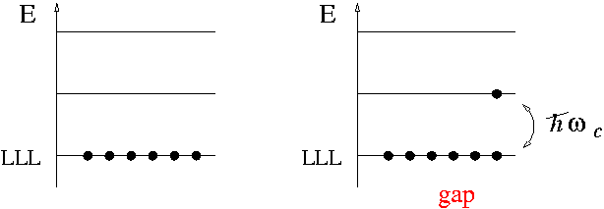
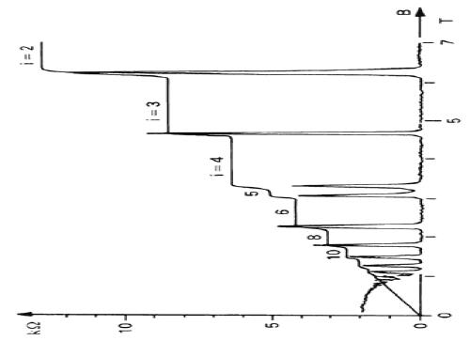


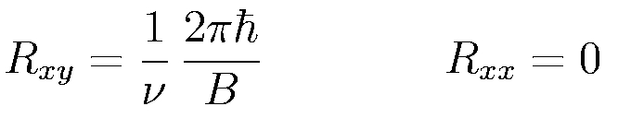

Integer Quantum Hall effect: “band structure”
spinless (for simplicity) and noninteracting electrons: atomic insulator
?
no plateaus ?!
Something is missing!
Topology

Slide 12
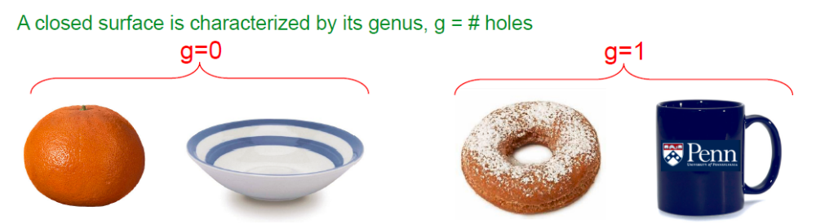
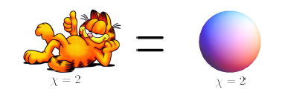
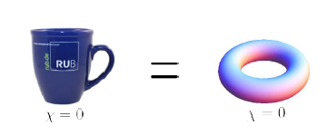
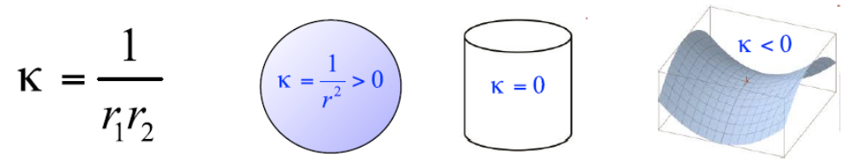
Topology: superficial introduction
Inequivalent objects cannot be continuously transformed into
each other
topology (genus) is a global property

Slide 13
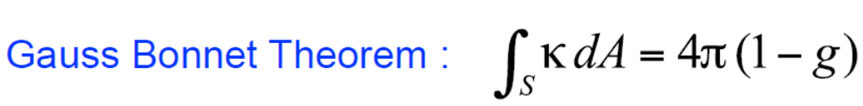
Topology: superficial introduction
geometric properties (such as curvature) are local properties
but integrals over local geometric properties may characterize global topology!
KFU, 19.05.2017

Slide 14
Topology and geometry in quantum mechanics
In quantum mechanics:
“geometry” relates to energy
“local deformations” ⇒ adiabatic changes of the Hamiltonian
“smoothness” (short-distance regularization)
of the manifold derives from an energy gap
the topology of quantum states is conserved
so long as energy gaps do not close

Slide 15
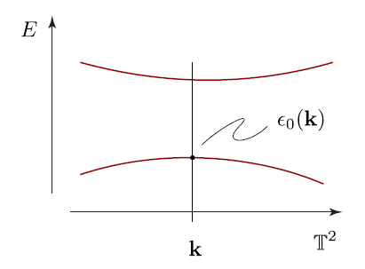




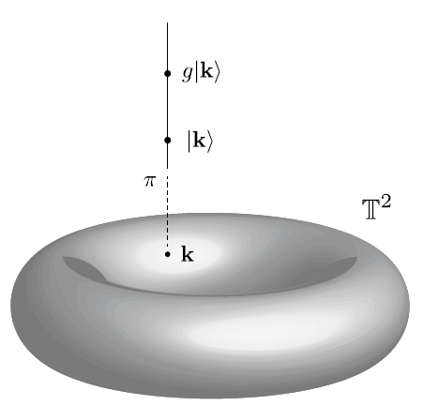

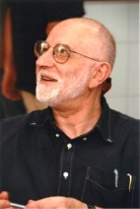
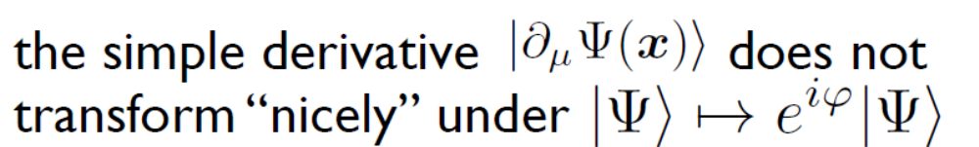
Band structure: Chern number as analog of genus
Quantum states are ambiguous up to a phase
defined only up to a global phase
Equivalence class of Hilbert space states
M. Berry: “this has profound consequences for a family
of quantum states”

Slide 16
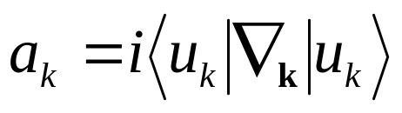
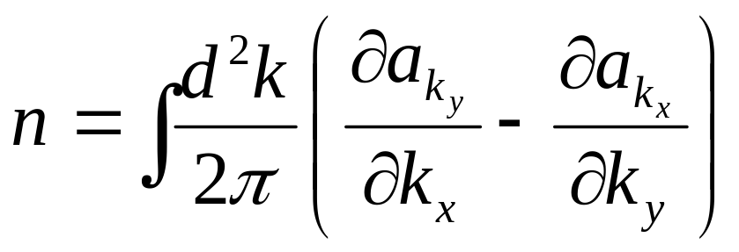

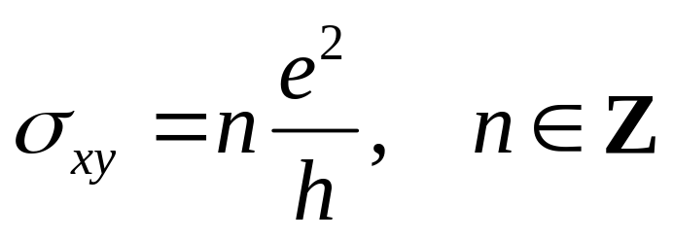
Topological invariant: Chern number
Berry (canonical) connection
an analog of the electromagnetic vector potential in the parameter space
‘Berry curvature’
first Chern number

Slide 17
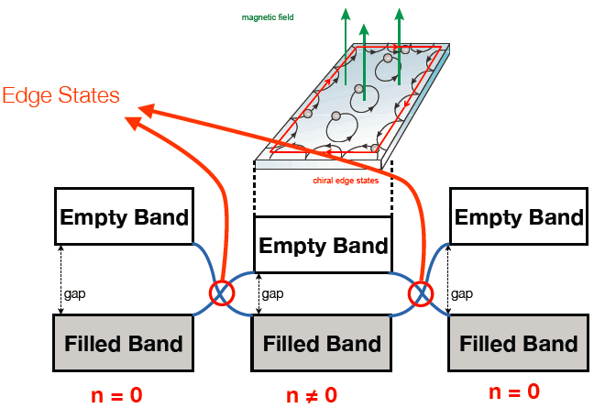
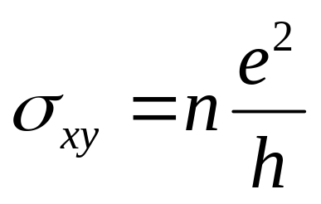
Topological invariant: Robust edge states at the interface of two ‘solids’ with different Chern classes
Robustness of topological invariant n (edge states)

Slide 18
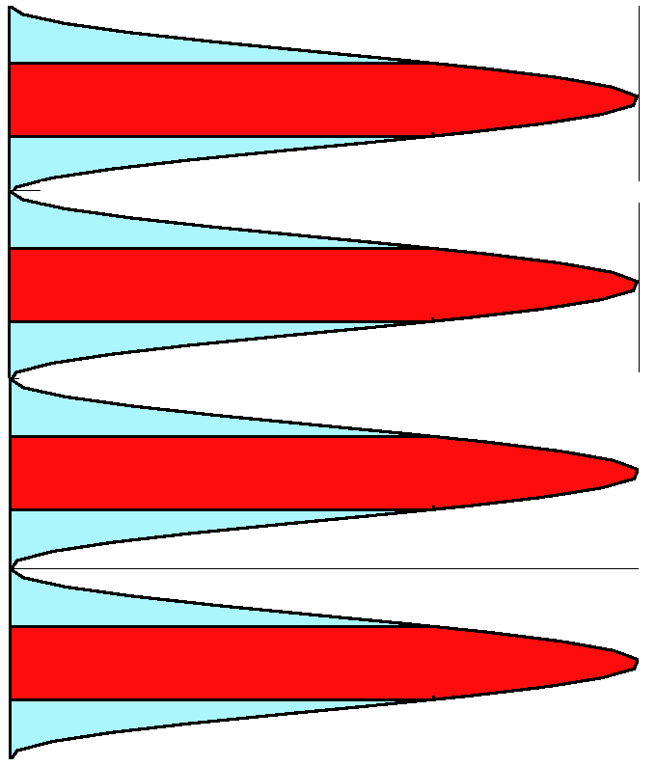
Integer Quantum Hall effect: “band structure”
Only topologically protected surface
states carry current!
Extended States
E
Localized States
DOS

Slide 19
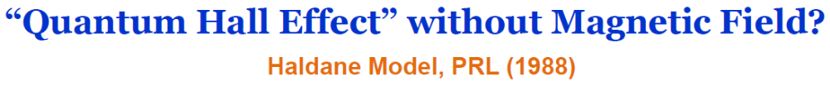
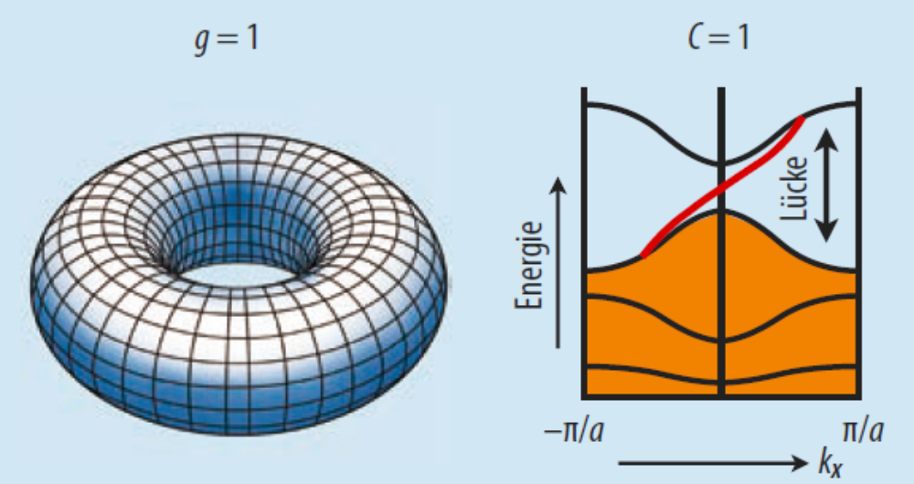
What is the topological insulator?
The band structure of some insulators encodes nontrivial topological structure
in cases where the bulk topology of the system is non-trivial, the surface actually shows metallic behavior, and rather unusual metallic behavior at that
Bochum, 14.11.2016

Slide 20
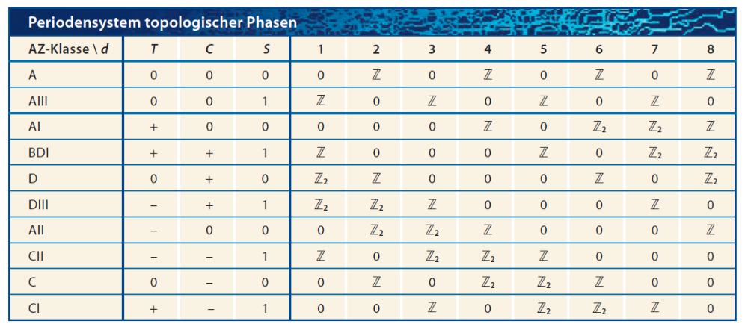
Where to look for non-trivial topology?
KFU, 19.05.2017

Slide 21
Outline
Prize motivation:
"for theoretical discoveries of topological phase transitions and topological phases of matter"
Band theory of solids and Quantum Hall Effect
Berezinskii-Kosterlitz-Thouless (BKT) phase transition
Non-trivial topology of the Haldaene spin chain
KFU, 19.05.2017

Slide 22
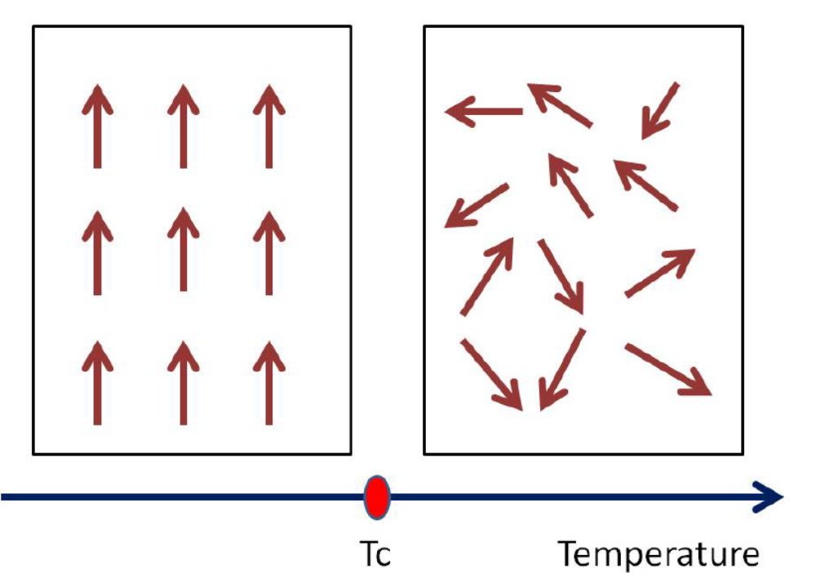
Phase transition and symmetry breaking
Ferromagnetism: Ordered phase in low-temperature, and the spin rotational symmetry is broken.
The phase transition are characterized by the ‘order parameter’
<S> = 0 for T > T_{c}, and <S> ≠ 0 for T < T_{c}
T > T_{c} two spins far away from each other are non-correlated, <S_{i} S_{j}>=0
T << T_{c} two spins far away from each other are correlated independent of the distance, <S_{i} S_{j}> = S(S+1)

Slide 23
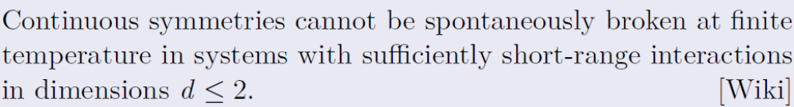
Phase transition and Mermin-Wagner Theorem
based on Bogoliubov inequality (Q-Mech 2)
KFU, 19.05.2017

Slide 24
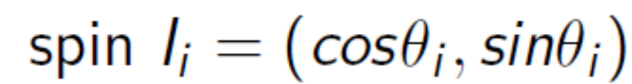
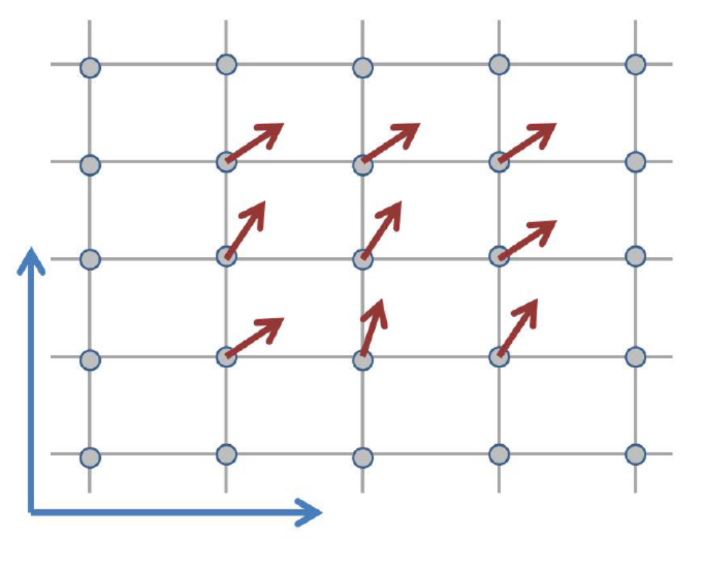
XY-Model on a 2D square lattice
Mermin-Wagner forbids the mean-field transition

Slide 25

XY-Model on a 2D square lattice
Numerical simulation: F-Praktikum
small temperatures - power-law decay (quasi-long range order)
- high temperatures the decay is exponential (should be for non-ordered phase)

Slide 26


XY-Model on a 2D square lattice: homotopy
mapping from the base manifold (space) to the target space (order parameter space)
θ angle must be an integral
multiple of 2πn
n- winding number
two mappings are called homotopic if they can be continuously deformed into each other

Slide 27




XY-Model on a 2D square lattice:
Topological defects (vortices) and Homotopy
Defects with different n are topologically protected

Slide 28

Vortex-Antivortex pairs in X-Y model
The topological defects appear in vortex-antivortex pairs (n=1 and n= -1)
KFU, 19.05.2017

Slide 29





T_{BKT} ⇒ temperature, below which topological defects cannot exist
- energy of the single vortex
- entropy of the vortex system
two disordered phases with diff. correlations
phase transition of infinite order

Slide 30




T_{BKT} ⇒ vortex-antivortex binding transition
Physical picture of XY model and Coulomb gas
in 2 dimensions
Positive and negative charges form a tight pair; dielectric material
Pair dissociation, metallic state

Slide 31



BKT transition: experimental realization
Josephson junctions arrays: main platform for the quantum computer realization

Slide 32





Analogy: symmetry enhancement in Grand Unified Theory
U(1)
SU(3)
Z₂
SU(5)
U(1)
SU(2)
Topological defects in 3+1: vortex loops, skyrmions, instantons, …
KFU, 19.05.2017

Slide 33


BKT transition: Bose superfluids with ultracold atomic gases
Zoran Hadzibabic et al, Nature 441 (2006)
Vortices as dislocations in the interference patterns

Slide 34
Outline
Prize motivation:
"for theoretical discoveries of topological phase transitions and topological phases of matter"
Band theory of solids and Quantum Hall Effect
Berezinskii-Kosterlitz-Thouless (BKT) phase transition
Non-trivial topology of the Haldane spin chain
KFU, 19.05.2017

Slide 35

Topology for the spin chains
What corresponds to topological insulators in quantum magnets?...
Quantum geometry (Berry phase) of the coherent states of a quantum spin
in one-spatial dimension, quantum fluctuations destroy long-range order, so GLOBAL (topological) structure becomes
important
KFU, 19.05.2017

Slide 36

Topology for the spin chains
What corresponds to topological insulators in quantum magnets?...
- The coherent state of the spin “lives” on a 2-manifold which is the unit sphere
Its Chern number is 2S, which must be topologically-
quantized to be an integer
- There is a further “Z2” classification by whether 2S is even or odd (integer or half odd-integer spins).

Slide 37

Haldane spin chain

Slide 38

Haldane spin S=1 chain
S=1 Heisenberg with gapped spectrum
M. Kenzelmann et al., Phys. Rev. B 66 (2002)
KFU, 19.05.2017

Slide 39



Haldane spin S=1 chain
What corresponds to topological insulators in quantum magnets?...
F. D. M. Haldane, Phys. Lett. A, 93, 464 (1983).
Haldane gap state is identified by non-local order parameter

Slide 40


Ground state of Haldane spin chain
Similarity to the
Topological Insulator
KFU, 19.05.2017

Slide 41
Conclusions
New directions in “topological phases of matter"
Stable single particle states with non-trivial topology (parafermions, Weyl and Majorana fermions)
Non-trivial topology of the spin systems: non-local order parameters, topological phase transitions
Applications for spintronics and quantum computing
KFU, 19.05.2017

Slide 42
Solid State Physics in Bochum
Novel materials, interfaces, and devices
Surface
and chemical physics
Fundamentals

Slide 43
Festkörperphysik:
Beteiligung an der Lehre
2013-2015: 76 Absolventen (Bachelor +Master)
2013-2015: 21 Promotionen

Slide 44




Festkörperphysik: Vernetzung innerhalb RUB
Materials Research Department

Slide 45





Festkörperphysik: Vernetzung innerhalb UAR
International Collaborative Research Centre TRR 160

Slide 46





Festkörperphysik: Vernetzung bundesweit
DFG SPP 1459 "Graphene"
FOR 1766
Q.com-Halbleiter
CO₂EKAT
eEthylen
+ Kooperation mit Industrie: Bosch, ThyssenKrupp, Benteler

Slide 47








Festkörperphysik: internationale Kooperationen
University of
Central Florida
University of
Minnesota
IIP, Brazil

Slide 48

Festkörperphysik: Forschung an Großgeräten

Slide 49

Festkörperphysik: Forschung an Großgeräten

Slide 50





macroscale
Engineering
microstructure
Materials Science
Discipline
Chemistry
atomistic
Physics
electronic
nm
μm
mm
m
ICAMS: materials modelling and design of technical materials as a scientific challenge

Slide 51


Teaching and Education at ICAMS
2 year Masters programme
all courses in English
opens pathways to careers in academia and industry
see www.icams.de/mss

Slide 52











Introduction: band theory of electrons in solids
For physical properties only a small number of bands really matter!
(no double occupancy)
The energy of the highest occupied state
is called the Fermi energy
The differences between the two is their behavior
with respect to the small perturbation
Bochum, 14.11.2016

Slide 53
Introduction: band theory of electrons in solids
external perturbation: external electric field, heat source, etc.
- Metal: small amount of energy can be deposited in the system
Insulator: the external energy is not enough to change the state of an insulator
Bochum, 14.11.2016

