Slide 1
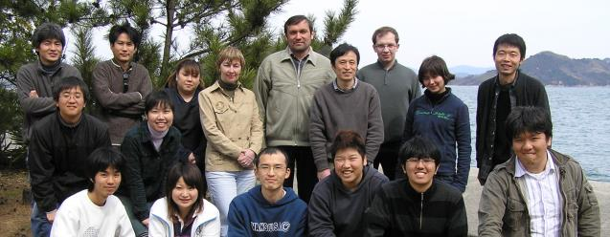
Decoding the Origin of the Most Eccentric Animal on This Planet
Декодирование происхождения самого эксцентричного животного на этой планете
Yasui Kinya
National Museum of Nature & Science/Tsukuba
Japan
September 2018, IFMB KFU

Slide 2
My long standing question was why I was here, that means how did human beings come to exist in the space?

Slide 3
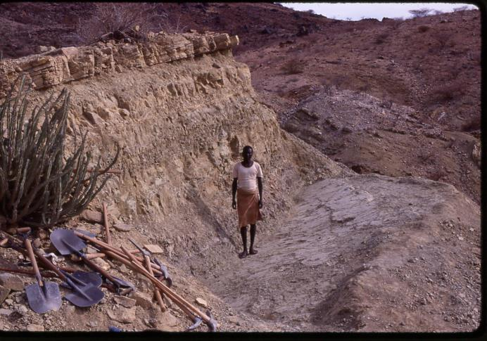
I was an anthropologist.

Slide 4
Currently, we are understanding:
Human ancestor was derived from the common ancestor with chimpanzee around 7 million years ago in Africa.
Some human ancestors migrated from Africa three times.
    First migration was by Homo electus
    Second migration was by likely ancestor of Neandertales and Denisovans.
    Last migration was by the ancestor of modern humans, Homo sapiens.
The modern human ancestor migrated out from Africa mixed with Neandertales and Denisovans in Eurasia.

Slide 5
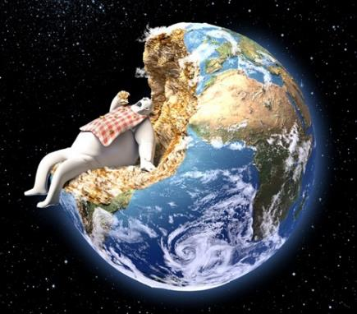
Now we human beings
are
only one human species in the world.
https://www.tes.com/lessons/g9teBlEWp-GWsw/curiosity-idea-people-are-dangerous-parasites

Slide 6
And now human beings
are
living in a high-tech world.
Artificial intelligence (AI)
Super high speed communication networks
Nucleic acid sequencing technology
whole genome sequencing
transcriptome analysis
Genome editing technology
CRISPR-Cas9 system
TALEN system
Visualization of molecular dynamics in organisms

Slide 7
We can do anything what we want.
from the Holocene to the Anthropocene

Slide 8
What are key events that made such a creature possible?
The answer is most likely
acquisition of medium

Slide 9
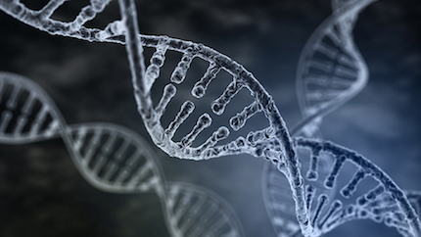
First key event (this is critical for organisms)
Acquisition of DNA
https://indeep.jp/dna-genom-epigenetics-of-human/

Slide 10
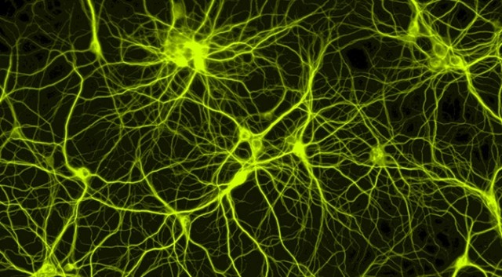
Second key event
Acquisition of neurons
https://www.extremetech.com/extreme/179223-the-first-real-time-non-invasive-imaging-of-neurons-forming-a-neural-network

Slide 11

Third key event
Acquisition of language
http://moodle.womenrunners.com/course/view.php?id=44

Slide 12
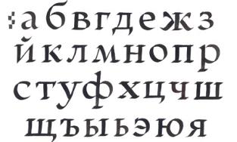
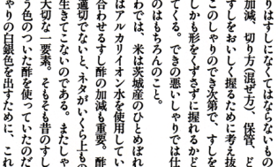
Forth key event
Invention of letters

Slide 13

Fifth key event
Invention of money
https://money-campus.net/archives/918

Slide 14

Last key event
Innovation of digital media
ON or OFF
PRESENCE
or
ABSENCE

Slide 15

As a result,
new technologies come to frighten traditional
common sense and deeply affect human life style,
only eight persons have the same monetary value of the property as the total value of the lower half of the world population (300 million persons).
Big numeral is deadly powerful, but also
big number is awfully helpless.
(The #1 in 2018 is the owner of Amazon, Mr. Jeff Bezos, whose monetary value of the property is larger than the annual governmental budget of Russia.)
This trend will get militant.
http://karapaia.com/archives/52189601.html

Slide 16
Why is human being so outstanding compared with other animals?
The most remarkable character of human being is characterless body
but
it is benefiting from one of the acquired media.
neurons

Slide 17
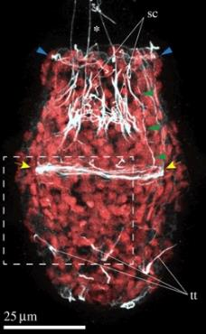
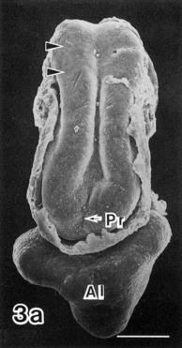
All animals excepting sponges have well-defined neurons,
but the nervous system is divided into two types.
mesenchymal origin
epithelial origin
Martín-Duran et al., 2015
Yasui, 1992

Slide 18
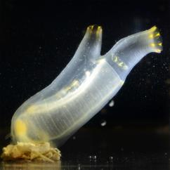
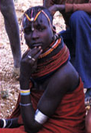

Epitherial type is found only in chordates.
cephalochordates
tunicates
vertebrates

Slide 19
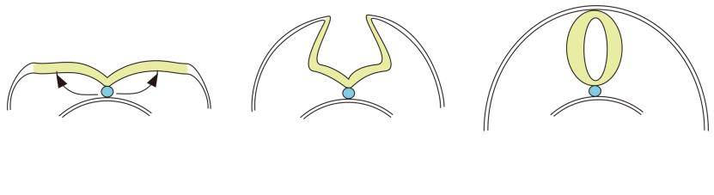
Why have only chordates acquired epitherial neural tissue?
neural plate
notochord
neural tube
We can ask how chordate ancestor acquired dorsal axial structure, notochord.

Slide 20
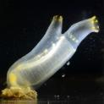
Lancelets look like active animals, but actually they are sedentary animals.
Tunicates are the closest animals to vertebrates, but they have derived very much likely because they have acquired cellulose-coding genes from bacteria. They discard neural tube during development.
Only vertebrates have elaborated neural tube. One possible reason is the acquisition of viewing eyes.

Slide 21
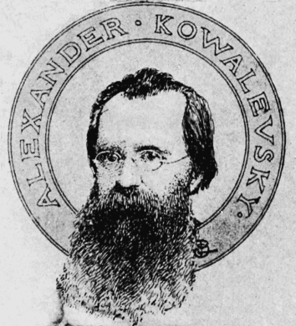
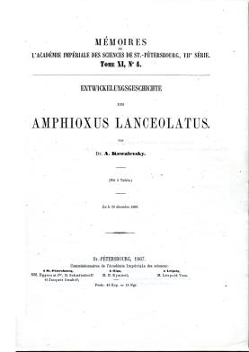
Who is the first scientist to have presented compelling data for proving the close phylogenetic relationship of lancelets and ascidians to vertebrates?
Александр Онуфриевич Ковалевский
from Locy, 1905

Slide 22
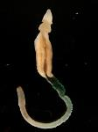
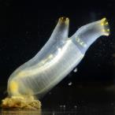
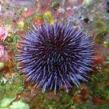
To understand the origin of dorsal structures,
we need to study not only chordates but also non-chordate kin.
Ambulacrarians
hemichordates
echinoderms

Slide 23
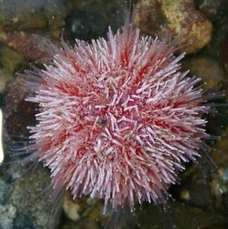
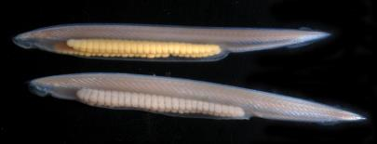
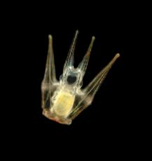
Deuterostomia
sea urchin (penta-radial)
lancelet (bilateral)
larvae (bilateral)

Slide 24
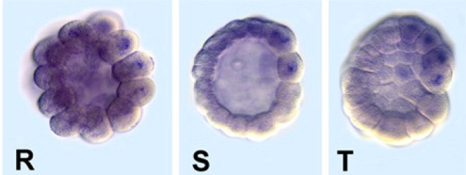
One of earliest expressed zygotic genes, lefty
in lancelet embryos
Onai et al., 2010

Slide 25
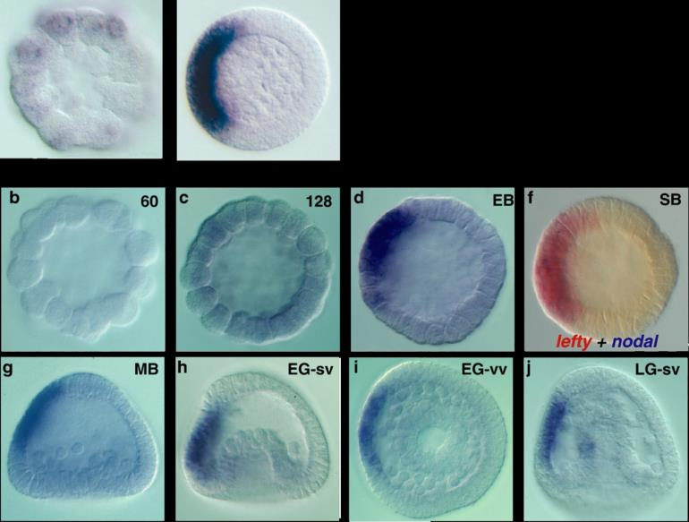
lefty gene expression
in
sea urchin embryos
(Molina et al., 2013)
nodal
(Duboc et al., 2008)
lefty

Slide 26
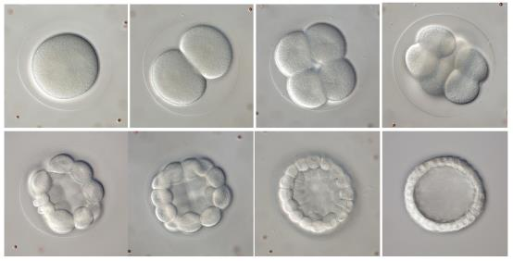

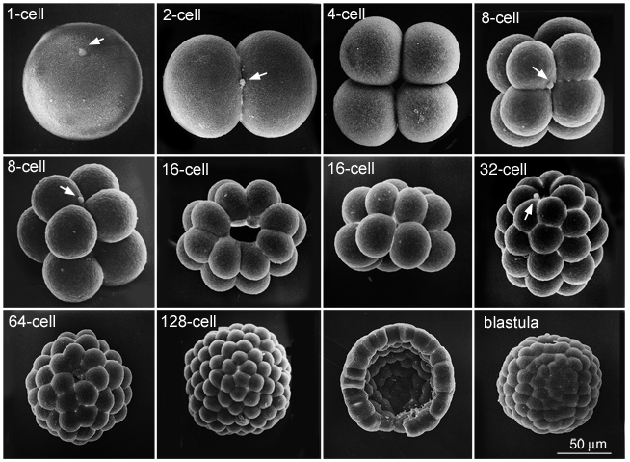

Cleavage pattern
http://gvondassow.com/Research_Site
sea urchin
lancelet

Slide 27
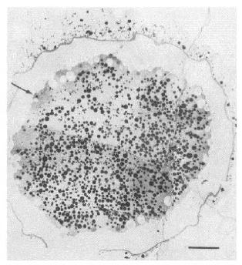
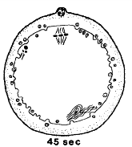
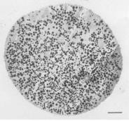
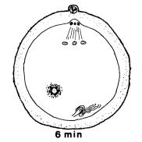
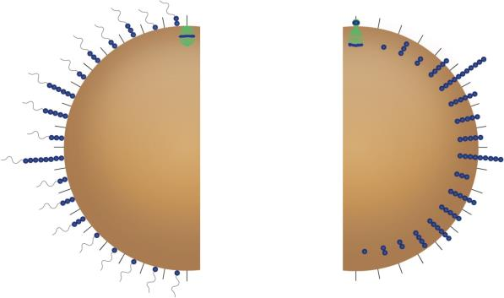
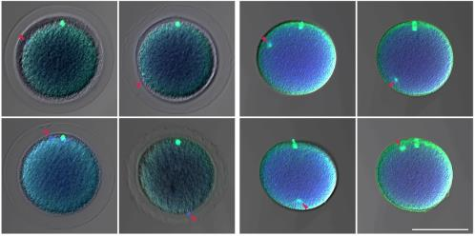
Sperm entry point on lancelet eggs
Holland ＆ Holland, 1992
1-2 min
5 min
n=48
n=72

Slide 28
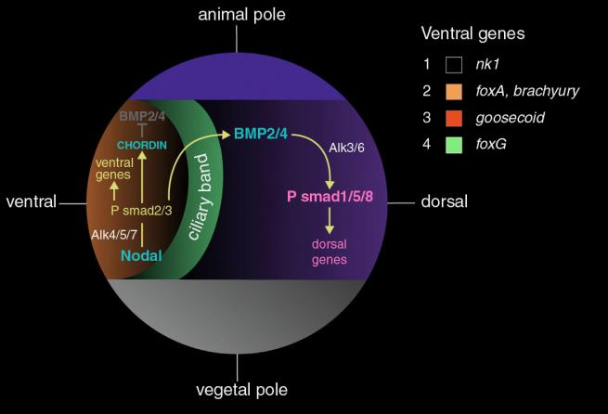
Is the oral region of sea urchin embryos homologous to
vertebrate organizer?
Molina et al., 2013

Slide 29
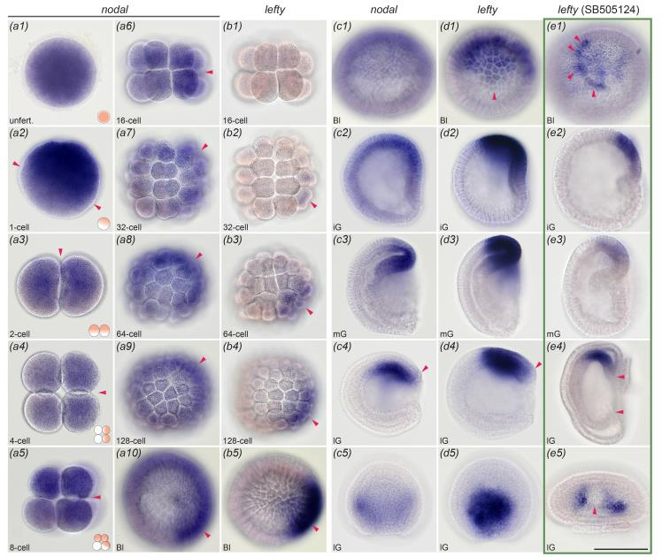
Maternal/zygotic nodal and zygotic lefty expression pattern in lancelet embryos

Slide 30
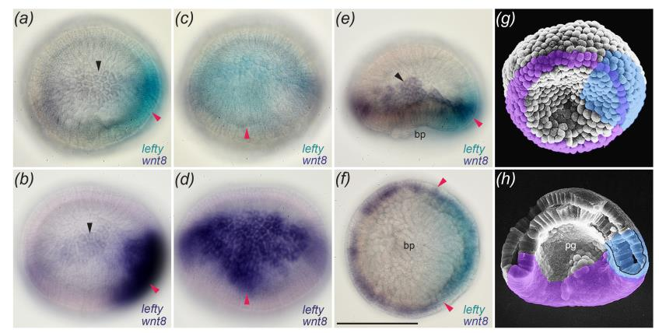
Where is lefty expressed in lancelet blastulae?

Slide 31
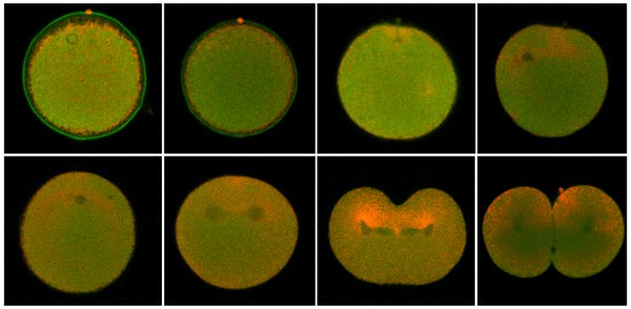
Why are nodal and lefy genes expressed asymmetrically?
Localization pattern of mitochondria during first cleavage
1-2 min
5 min
10 min
20 min
25 min
1st cleav.
1st cleav.
2-cell

Slide 32
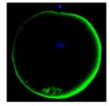

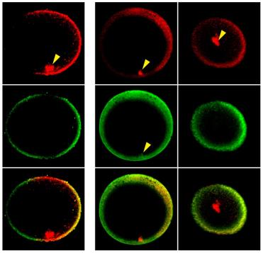
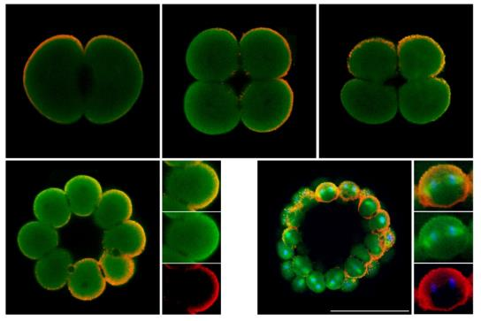
Asymmetric pattern of active Arp2/3 complex and its co-localization with cortical filaments
pArp2
Animal
unfertilized
1-2 min
5 min
15 min
25 min
35 min
polar body
tuft struct.
Vegetal
pArp2
pArp2
Tubulin
pArp2
pArp2
pArp2
2-cell
4-cell
8-cell
Actin
Tubulin
Tubulin
merged
merged
merged
16-cell
64-cell

Slide 33
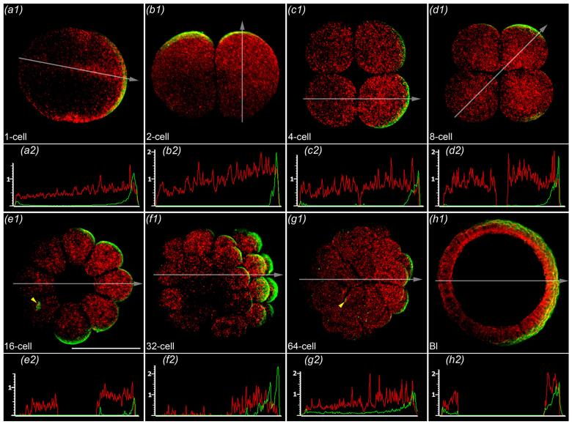
Distribution pattern of nodal mRNA
and active Arp2/3 complex

Slide 34
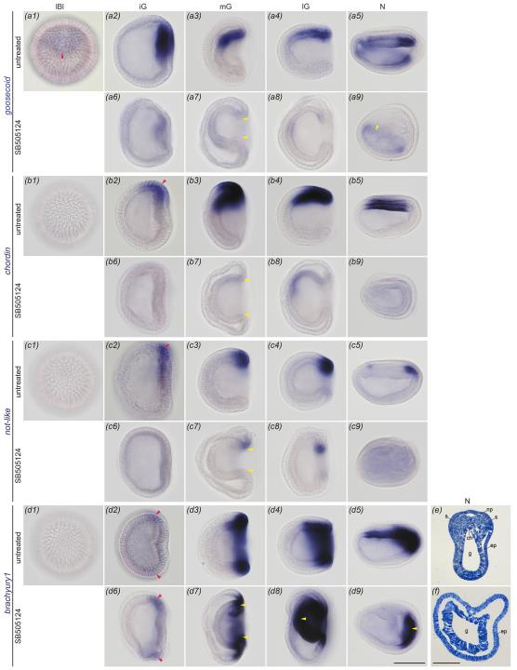
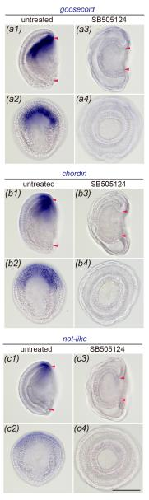
Inactivation of dorsal
specific genes in embryos
treated with Nodal inhibitor

Slide 35
Larval mouth in echinoderms
is likely homologous with
chordate dorsal structures.

Slide 36
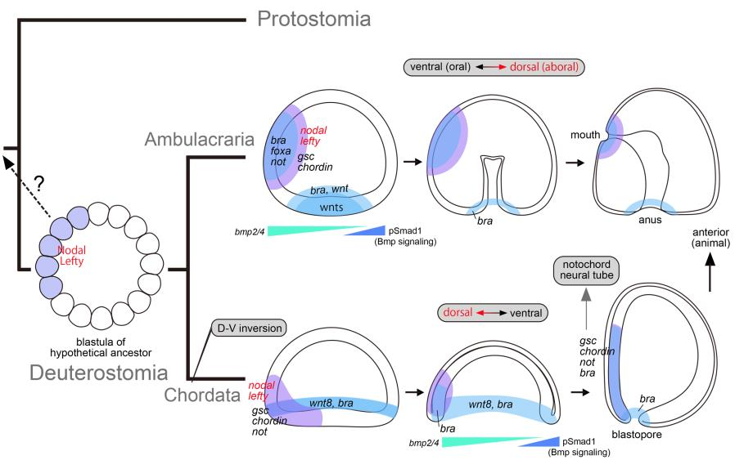
Possible scenario for the origin of lancelets (or probably chordate ancestor) with dorsal-ventral inversion

Slide 37
Chordates utilized molecular mechanisms
underlying mouth formation in the ancestor
to form the new dorsal structures instead.
How do chordates get their mouths?

Slide 38
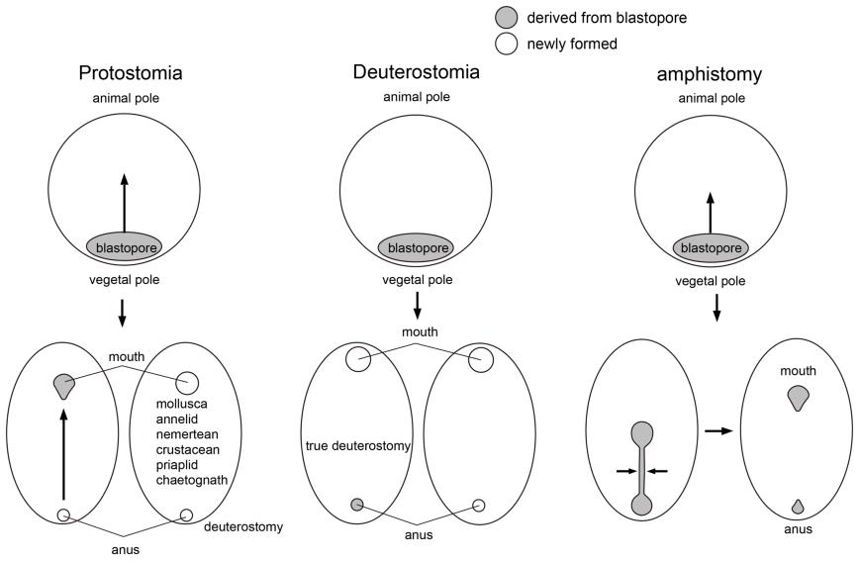
Blastopore and mouth

Slide 39
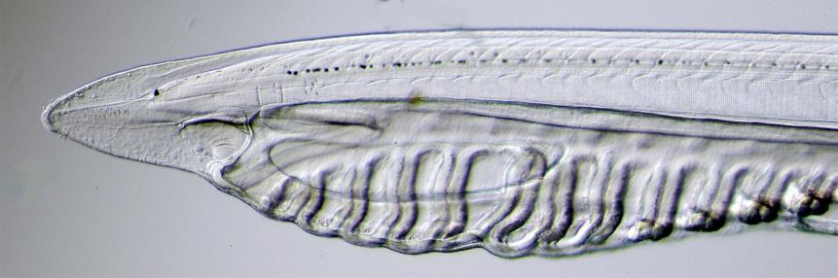
Amphioxus mouth is strange !

Slide 40
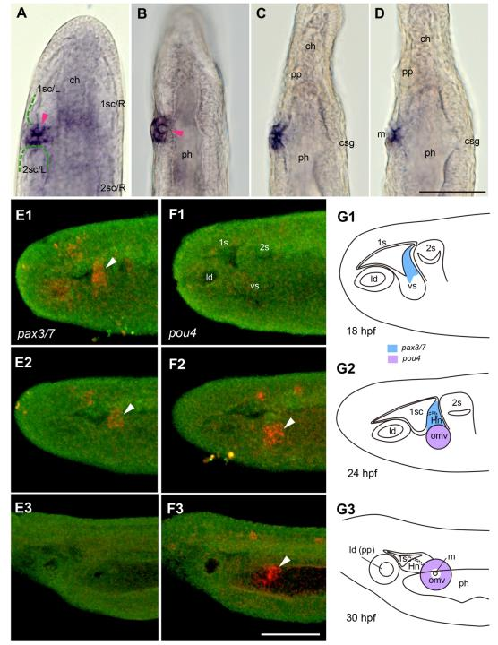
pou4
Classical studies regarded
the cell mass as the anlage
of Hatschek nephridium.

Slide 41
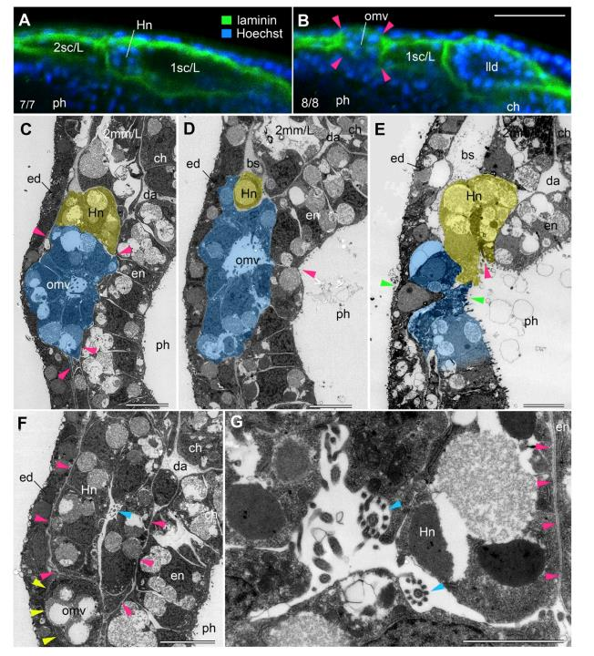

Slide 42
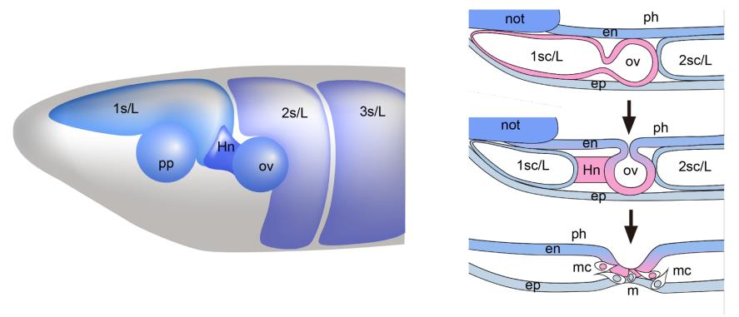
How do lancelet larvae open the mouth?
Oral formation in amphioxus larvae

Slide 43
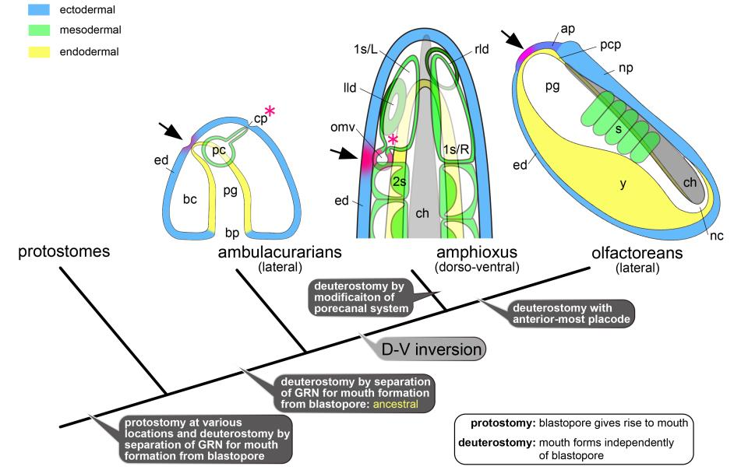
Mouths in deuterostomes

Slide 44
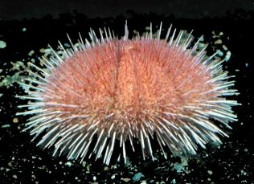


О, ты мой брат!
How was our ancestor?

Slide 45
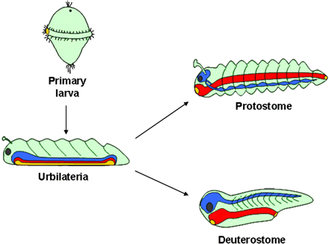
What is Urbilateria?
De Robertis, 2008

Slide 46


The oldest echinoderm fossils
Helicoplacoid, the oldest echinoderm fossil
Helicocystis
Durham and Caster, 1963
Smith and Zamora, 2015

Slide 47









Bilateral animals showing
radial symmetric appearance

Slide 48




Lowest Cambrian sediments in China
中国陜西省
西郷県譚家院子

Slide 49



Conical fossils from the earliest Cambrian
penta-radial conical fossil
Steiner et al., 2014
tetra-radial conical fossil

Slide 50

cleaving embryo
gastrula
hatchling
Ontogeny of penta-radial
conical fossils
body after hatching
embryonic body
embryonic body
growing body
blastocoel

Slide 51

A possible developmental pattern
of
the penta-radial conical fossil

Slide 52


Ernst Heinrich Philipp August Haeckel
Gastraea theory

Slide 53





Cnidarian and bilaterian ancestors might be very similar
in appearance and might be benthic.
bacterial mat on early Cambrian sea floor

Slide 54





Dr. Arseniy R. Morov contributed very much to the project of dorsal structure acquisition in chordates.
Dr. Takao Kaji contributed to the project of lancelet mouth.
Prof. Jian Han of Northwest Univ. China is a co-worker from the beginning of the project of earliest Cambrian small shelly fossils.
Спасибо за внимание и желаю вам успеха

