Slide 1

Marcin Dembowski
Oxford University Press – partner for academic community
Kazan
September 2014

Slide 2
Agenda for the session
About OUP
Products ...
To ‘demystify’ the publishing process
To provide tips, insider knowledge and key questions to maximize your chances of publication
Q&A session: ask anything!
Follow-up: I’m always available to help
To get you sharing your knowledge, i.e. to get you writing

Slide 3
Oxford University Press

Slide 4

Oxford University Press (OUP)
Our mission
Oxford University Press is a department of the University of Oxford. It furthers the University's objective of excellence in research, scholarship, and education by publishing worldwide.
John Fell
Clarendon Presentation—Tim Barton (November 2011)

Slide 5

Digital publishing
Across multiple sectors: Law, Medicine, Reference, Academic, Trade, Journals, Dictionaries…
40 + online products
Multiple data types and data models
One very simple data strategy: XML
Notes:
GAB publishes a huge variety of content.
We already have more than 30 online products, the first being published over 10 years ago now
There is a multitude of data types and data models because of all those different sectors and different content – law reports, books, reference books, journal – they’re all slightly different in the way they’re structured.
We therefore have one very simple data strategy – XML: Get all content into XML and then output into whatever format we want it to be in.

Slide 6
We support each stage of higher education
Supporting students education – high level of subject overviews in Oxford Textbooks, Oxford Handbooks online and monograph published in University Press Scholarship Online
Supporting researchers – Oxford Journals and Archives
Supporting publishing possibilities – large varieties of products

Slide 7
Supporting Research and Publications
Oxford Dictionaries
Oxford Journals
Oxford Handbooks Online
Oxford Scholarship Online/University Press Scholarship Online
Very Short Introductions
Oxford Bibliographies Online

Slide 8
How to get published with international journals?

Slide 9

Before you start………….
You must have a clear topic
or topics to be reviewed,
what is your research
question?

Slide 10
Ideas where to start
As well as ‘traditional’ research…
Are you working on a Doctoral or Master’s thesis?
Have you completed a project which concluded successfully?
Are you wrestling with a problem with no clear solution?
Do you have an opinion or observation on a subject?
Have you given a presentation or conference paper?
If so, you have the basis for a publishable paper

Slide 11

Editors are looking for “something new and preferably surprising” according to Dr. Peter Smith, a Cambridge philosopher and former editor of Analysis, the philosophical journal.
NEW IDEAS
NEW IDEAS
NEW IDEAS

Slide 12
Be Careful:
There are 1,000,000’s of published studies. You need to MASTER your topic: be aware of works completed by others, updates or/and be ready to answer questions or summarize it.

Slide 13
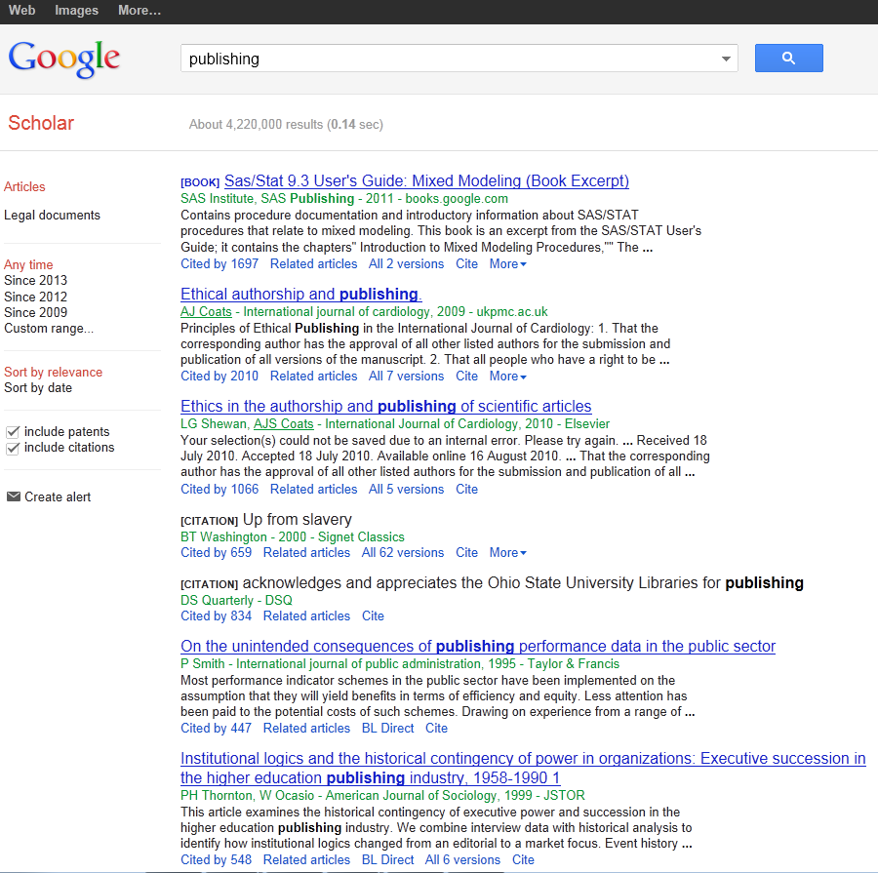
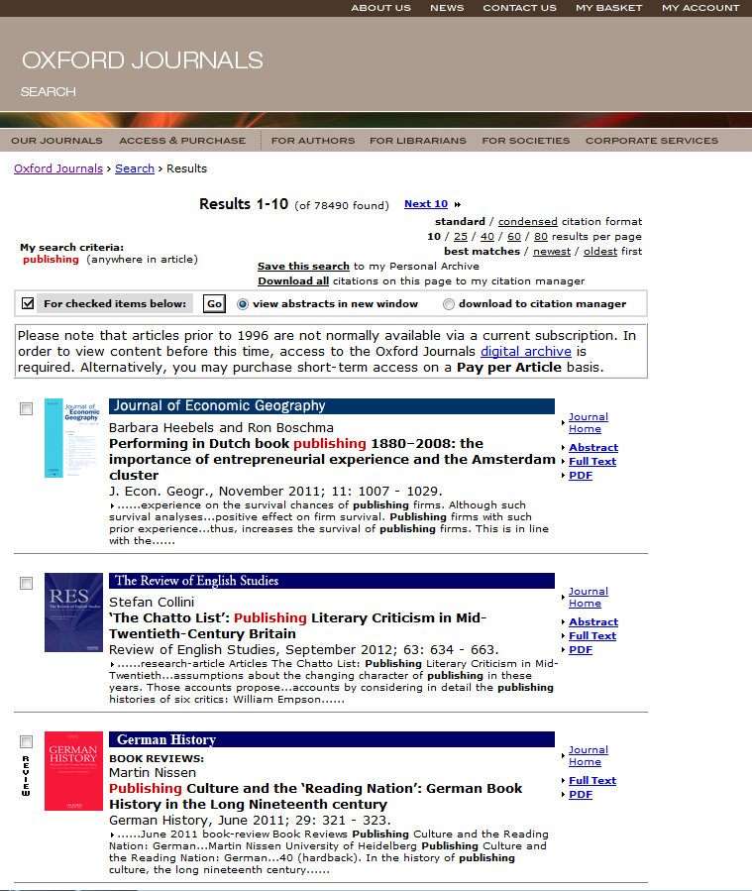
References:

Slide 14
Oxford Bibliographies Online
OBO is a library of discipline-focused, online guides to the essential literature across a broad range of subject areas.
Each OBO article, written and reviewed by top scholars in the field, is rich with citations and annotations, expert recommendations, and narrative pathways through the most useful and important works on the topic in question.
Intuitive linking throughout quickly delivers the user from a citation to full-text content, whether online or available through a library’s catalog.
“We are drowning in information, while starving for wisdom. The world henceforth will be run by synthesizers, people able to put together the right information at the right time, think critically about it, and make important choices wisely.”
— E.O. WILSON
Notes:
Quote from Edward Osborne Wilson Harvard University professor and 2 time winner of the Pulitzer prize.
27 subject areas available; launching 10-12 new subjects each year
Every subject area has an Editor-in-Chief and Editorial Board, and each article receives multiple peer reviews and board vetting
50-100 articles at launch per subject (equivalent to a 4-volume print encyclopedia)
Updated regularly, with 50-75 articles added per year to each subject area. Updates will also include revisions to existing articles.
It is selective, rather than exhaustive; expert recommendations with critical supportive text and annotation are provided to help cut down on time needed for preliminary research
Articles contain recommendations for scholarship at all levels, from encyclopedias and textbooks to journal articles and data sets – whether you’re starting a research paper, studying for qualifying exams, or preparing a syllabus, OBO is the perfect starting place
Includes indexing of non-print material, especially online resources

Slide 15
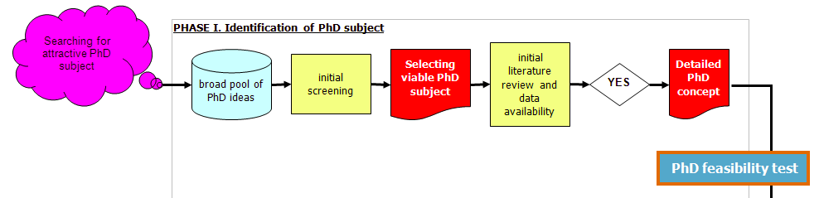
Our Focus

Slide 16
Initial literature review: The 5 X 5 principle
Identify 5 top peer refereed academic journals focusing on
your specific subject
Identify 5 top internationally recognized books or collective
works on your specific subject
Identify 5 top academic research centres specializing in
your subject
Identify 5 most renowned professors in your narrow field
(„gurus”)
Identify 5 top regular international academic conferences
covering your subject

Slide 17

Think of a literature review as a jigsaw puzzle

Slide 18

Which journal to go for?

Slide 19
Criteria You Might Look At:
Rankings (example Thomson Reuters Impact factors; the Association of Business Schools ABS etc.)

Slide 20
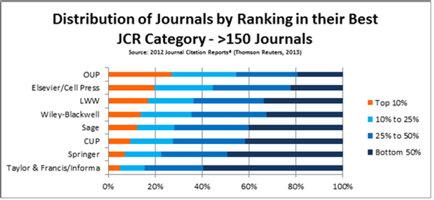
OUP Journals
Impact Factor Improvement, 2012

Slide 21
Criteria You Might Look At:
Rankings (example Thomson Reuters Impact factors; the Association of Business Schools ABS etc.)
Number of downloads (utility)
Dissemination of journal (where it is read)
Links to societies/associations
Relevance of content and publishing ethos
International

Slide 22
Questions to Ask Yourself
When Choosing:
What are your most important factors when choosing a journal?
Which resources do you use to research the journals you publish in?
Which rankings do you use? How important are they?
Who do you ask for advice?
What is the best journal in your field? Why?

Slide 23

PROCESS!!!!!
Putting A and B together to build up your work

Slide 24
Surviving peer review
Not always straight forward proccess

Slide 25
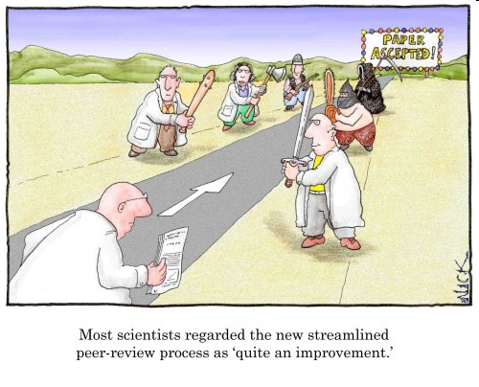
Research is all about peer review
You need to avoid a desk reject
You may need to revise and resubmit
You will almost certainly need to alter your paper

Slide 26
The Process
Submission is an important step on the road to being published
Reviewers are selected for their expertise by the Editors
They do sometimes make mistakes and their opinions may not be valid
But generally they raise genuine concerns about the work – conceptualization, execution and/or interpretation of the work

Slide 27
The Process
Their comments are aimed at maintaining the quality of papers publish in the journal, the overall journal reputation and ultimately at improving your work to attain a high standard of academic writing.

Slide 28
Process Conclusion:
Identify a few possible target journals but be realistic
Follow the Author Guidelines: scope, type of paper, word length, references style, etc.
Find where to send your paper (editor, regional editor, subject area editor) …
… and how to send it (email, hard copy, online submission)
Send an outline or abstract to editor: is it suitable? how can it be made so?
Read at least one issue of the journal

Slide 29
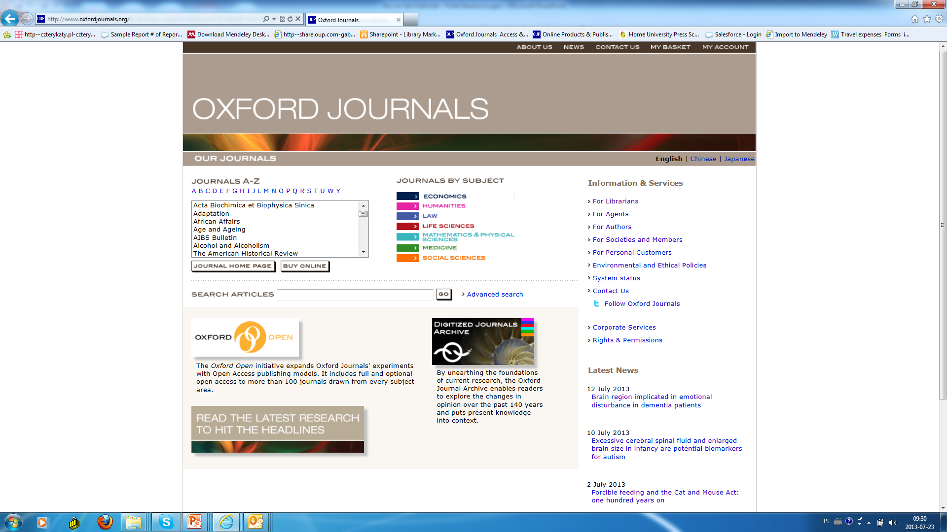

Slide 30
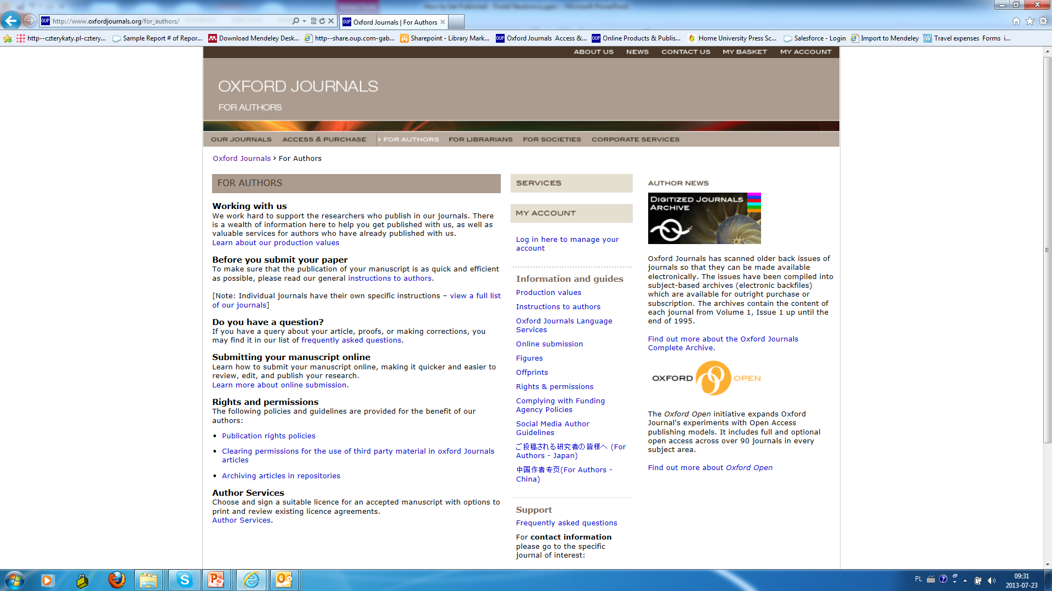

Slide 32
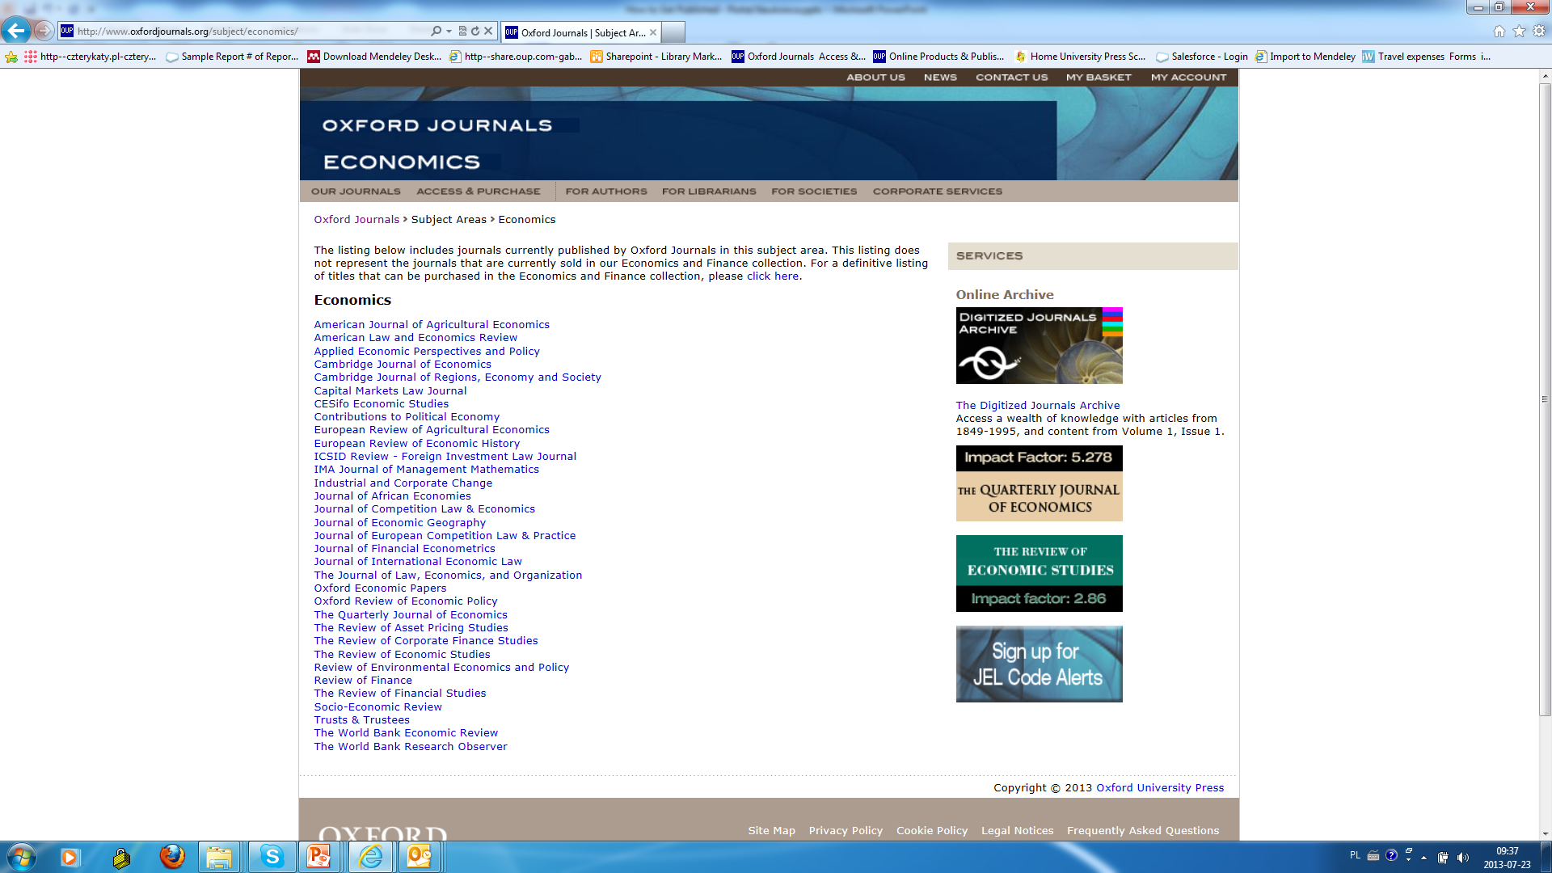

Slide 33
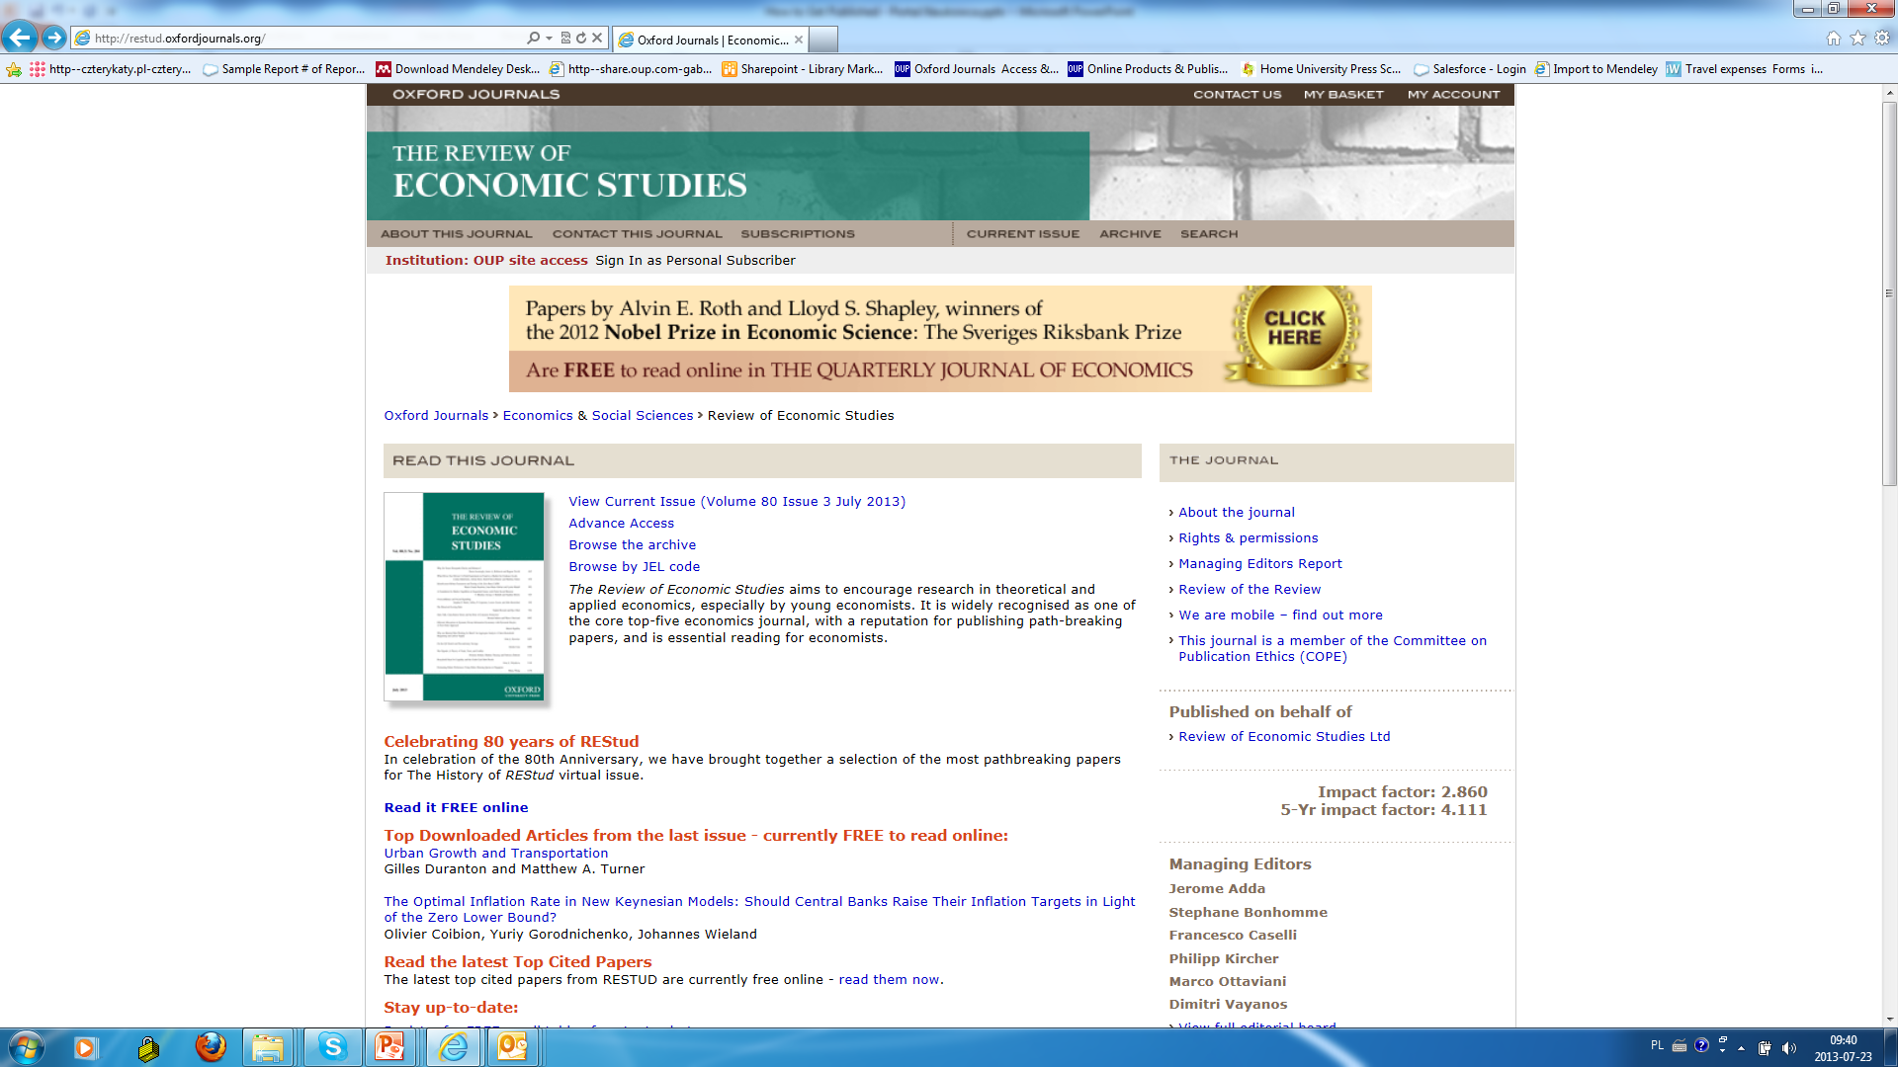

Slide 34
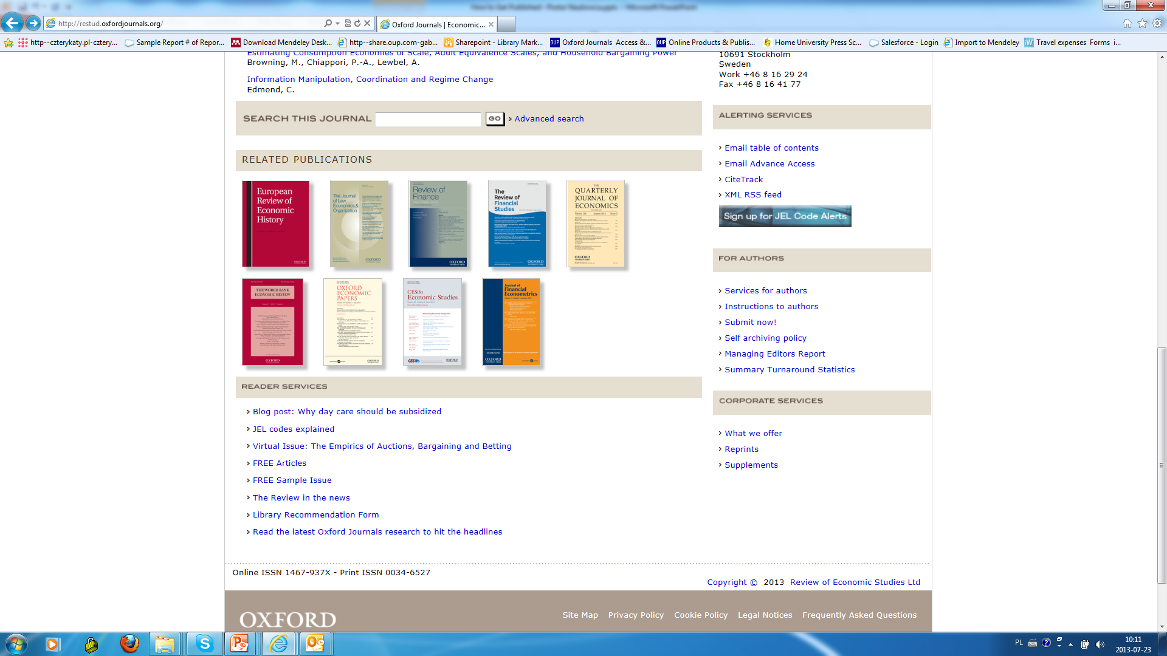

Slide 35
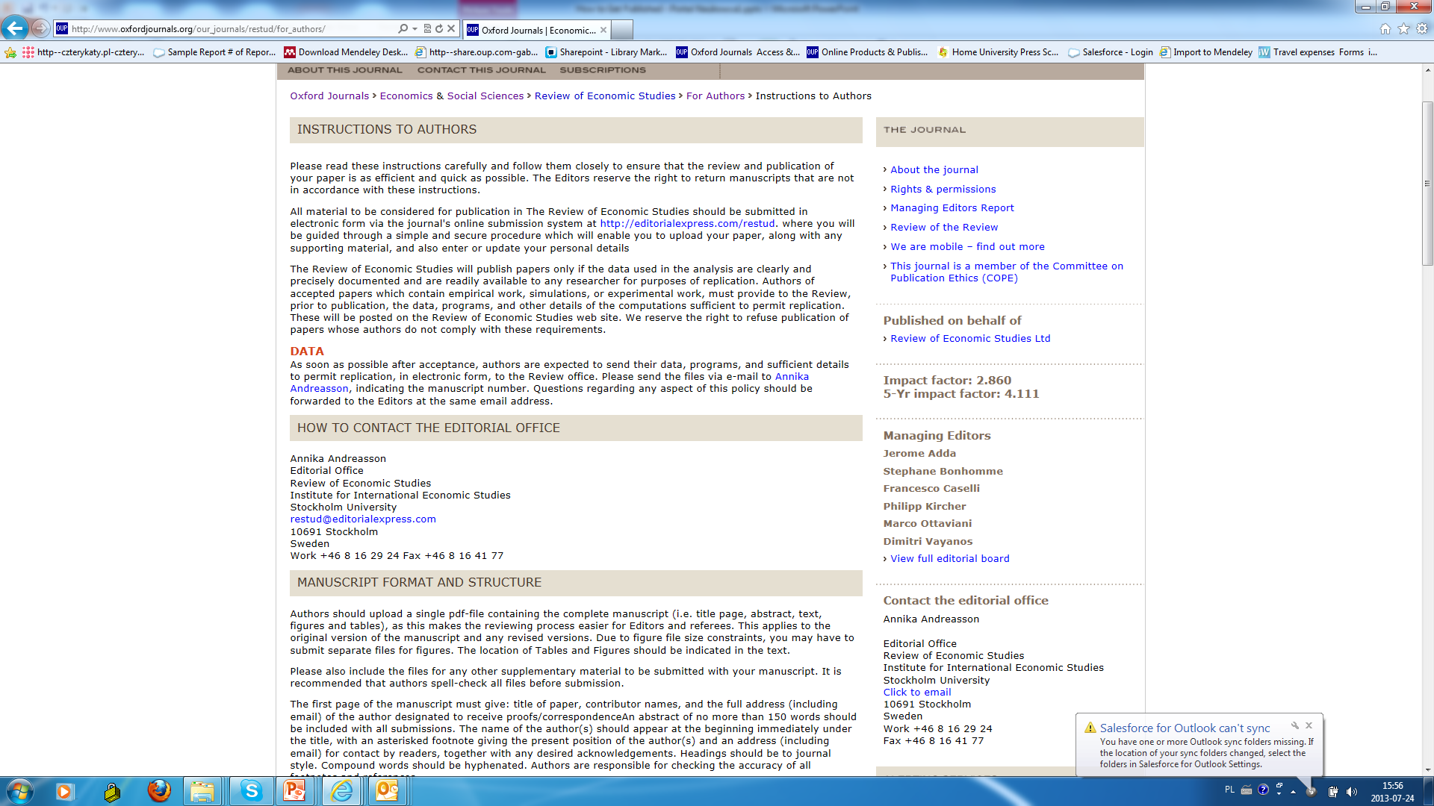

Slide 36
What makes a good paper?
HINT: Editors and reviewers look for …
Originality – what’s new about subject, treatment or results?
Relevance to and extension of existing knowledge
Research methodology – are conclusions valid and objective?
Clarity, structure and quality of writing – does it communicate well?
Sound, logical progression of argument
So what?’ factors!
Recency and relevance of references
Adherence to the editorial scope and objectives of the journal
A good title, keywords and a well written abstract

Slide 37
Co-authorship?
With supervisor, different departments or institutions
Exploits individual strengths
Especially useful for cross-disciplinary research
Demonstrates the authority and rigour of the research
Increases potential pool of citations
But remember
Ensure paper is edited so that it reads as one voice
Identify the person responsible for closing the project
Agree and clarify order of appearance of authors

Slide 38
Peer Review:
Peer Review is important to assess your work before submitting it.
Have fellow colleagues, tutors, scholars look at your work and give you feedback to avoid desk rejection. You do not want to be refused by appearing uninformed concerning your submission.
Always expect that you would have to amend, alter and revise your paper to submit a more accurate version.

Slide 39
Plagiarism and referencing
Plagiarism (from the Latin plagium meaning ‘a kidnapping’) is the act of taking someone else’s work and pretending it is yours. It is considered fraud!
It isn’t always detected in peer review but electronic tools can help

Slide 40
Revising
A request for revision is good news!
  You’ve avoided a desk reject and you are in the publishing cycle
  Nearly every published paper is revised at least once
  So now, close the deal!
Acknowledge the editor and set a revision deadline
Clarify if in doubt – ‘This is what I understand your comments to mean…’
Meet the revision deadline
Attach a covering letter showing how you met the reviewers’ requests (or if not, why not)

Slide 41
Dealing with the comments:
Answer as completely as possible
Answer politely, be tactful and not with emotive language
Answer with evidence
If you feel the reviewer has misunderstood then address the point with a good argument explaining why the reviewer is mistaken
  It may be the reviewers are conflicted on a point
  It is ok to use one reviewer to argue against another

Slide 42

In case of rejection:

Slide 43


Slide 44
If your article is rejected
Ask why, and listen carefully!
Most editors will give detailed comments about a rejected paper. Take a deep breath, and listen to what is being said
Try again!
Try to improve the paper, and re-submit elsewhere. Do your homework and target your paper as closely as possible
Don’t give up!
At least 50% of papers don’t get published. Everybody has been rejected at least once
Keep trying!

Slide 45
How to sell your work
Use a short descriptive title containing main keyword – don’t mislead
Write a clear and descriptive abstract containing the main keywords and following any instructions as to content and length
Provide relevant and known keywords – not obscure new jargon
Make your references complete and correct – vital for reference linking and citation indices
All of this will make your paper more discoverable which means more dissemination and possibly more citation

Slide 46
YOU DID IT!!!!!!!

Slide 47
OUP
SUPPORTING ACADEMIC RESEARCH

Slide 48
OUP wants to….
Increase and improve submissions to OUP journals and other products from the region

Slide 49
What OUP is planning to offer for researchers
GLOBAL AUTHOR SERVICES
Develop and provide focussed learning resources and programs to help researchers to improve their use of English in academic writing
Advice to younger researchres on research trends

Slide 50
What OUP is planning to offer for Russian researchers
GLOBAL AUTHOR SERVICES
Editing service focused on science and medical editing
More is comming soon ....

Slide 51

The book publishing process at OUP
Broad guidelines for authors
Diverse publishing programme befitting each subject area
Online Academic Publishing:
  NOT ONLY JOURNALS
  Oxford Bibliographies Online
  Oxford Handbooks Online
  University Press Scholarship Online
  Or other products
  Choose the resource that best fits your research
  Contact the relevant department directly

Slide 52
The publishing process at OUP
Benefits for authors
We offer our authors
Quality and speed of production
Excellent editing
Unrivalled worldwide sales, marketing, and distribution services.
Our aim is to maximize the benefits for authors that come from working with focused and dedicated publishing teams who operate as part of a large and international publisher.
We are committed to innovative publishing, publishing in print and electronic form, and we particularly welcome new ideas and feedback from our authors and readers.

Slide 53
Supporting Research and Publications
Oxford Dictionaries
Oxford Journals
Oxford Handbooks Online
Oxford Scholarship Online/University Press Scholarship Online
Very Short Introductions

Slide 54

Any Questions…
Marcin Dembowski
Regional Manager – Russian Federation, Baltic States & CIS Countries
marcin.dembowski@oup.com

