Slide 1

DIELECTRIC RELAXATION IN POROUS MATERIALS
Yuri Feldman
Tutorial lecture 5 in Kazan Federal University

Slide 2
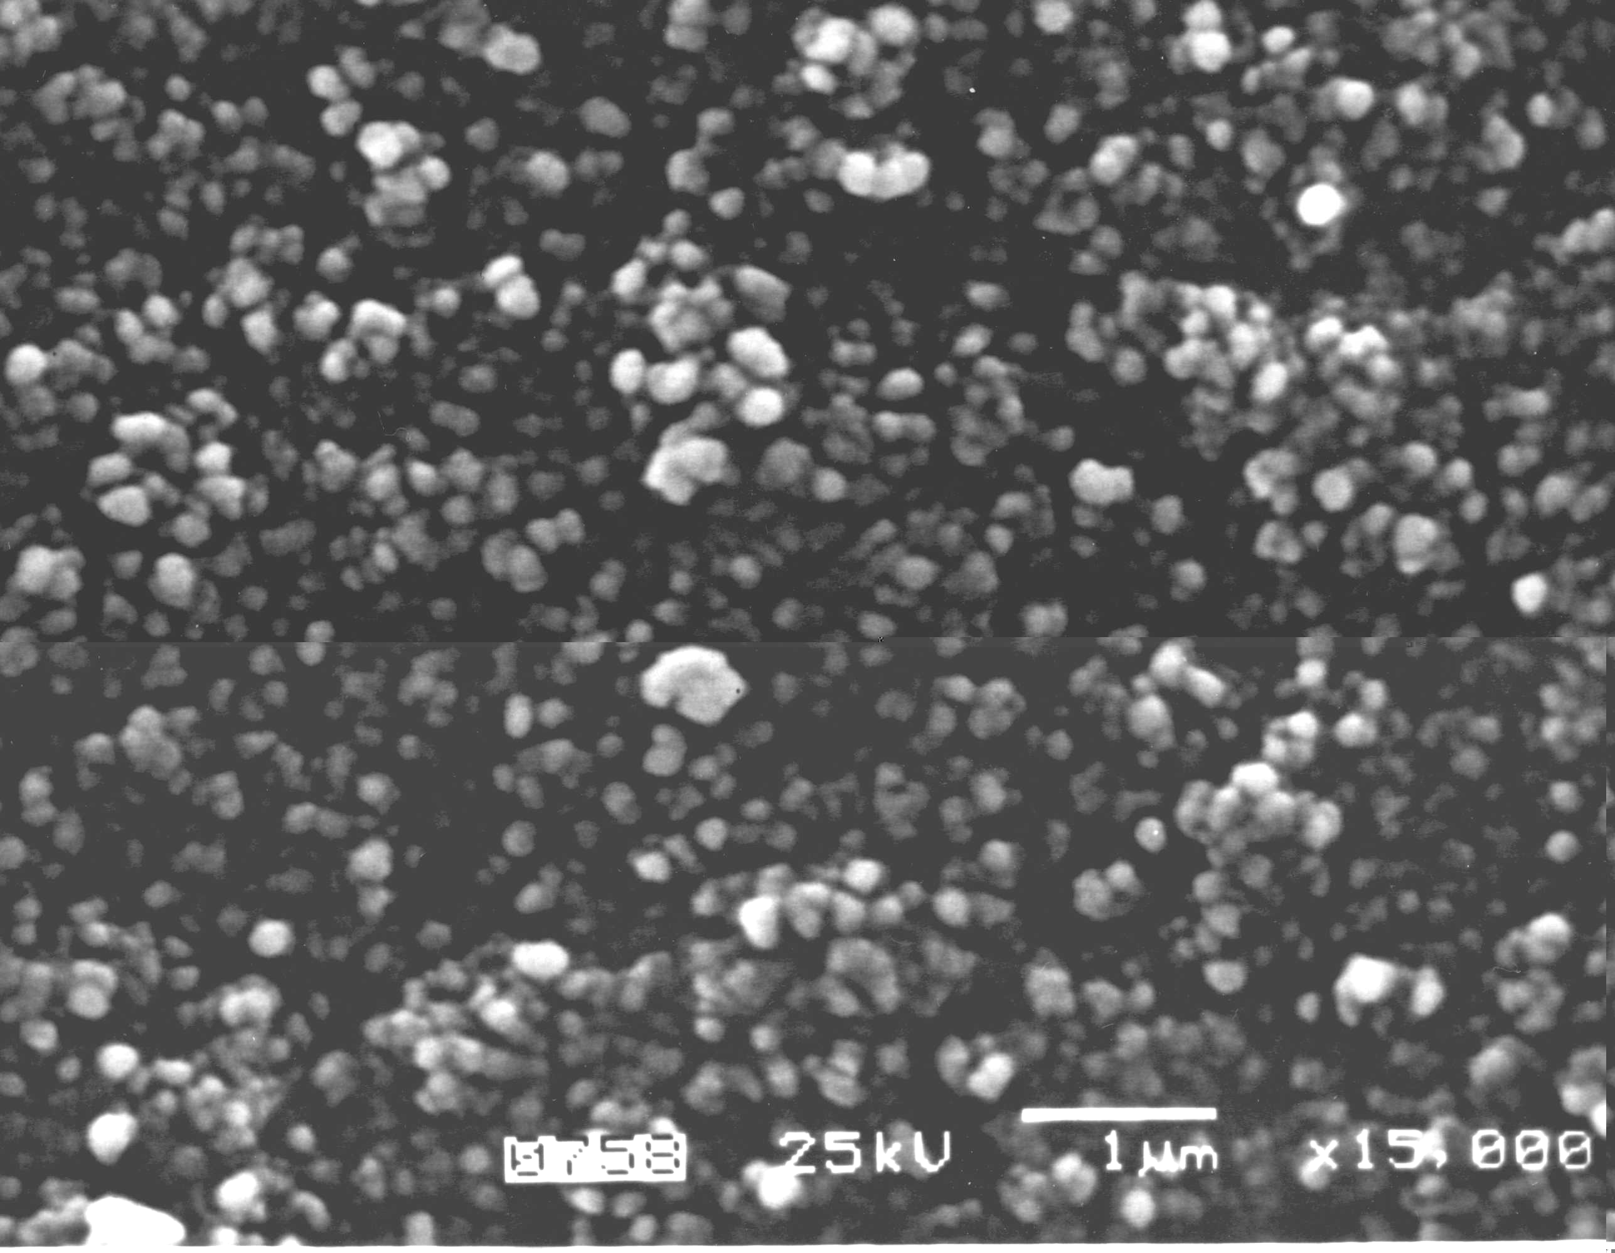
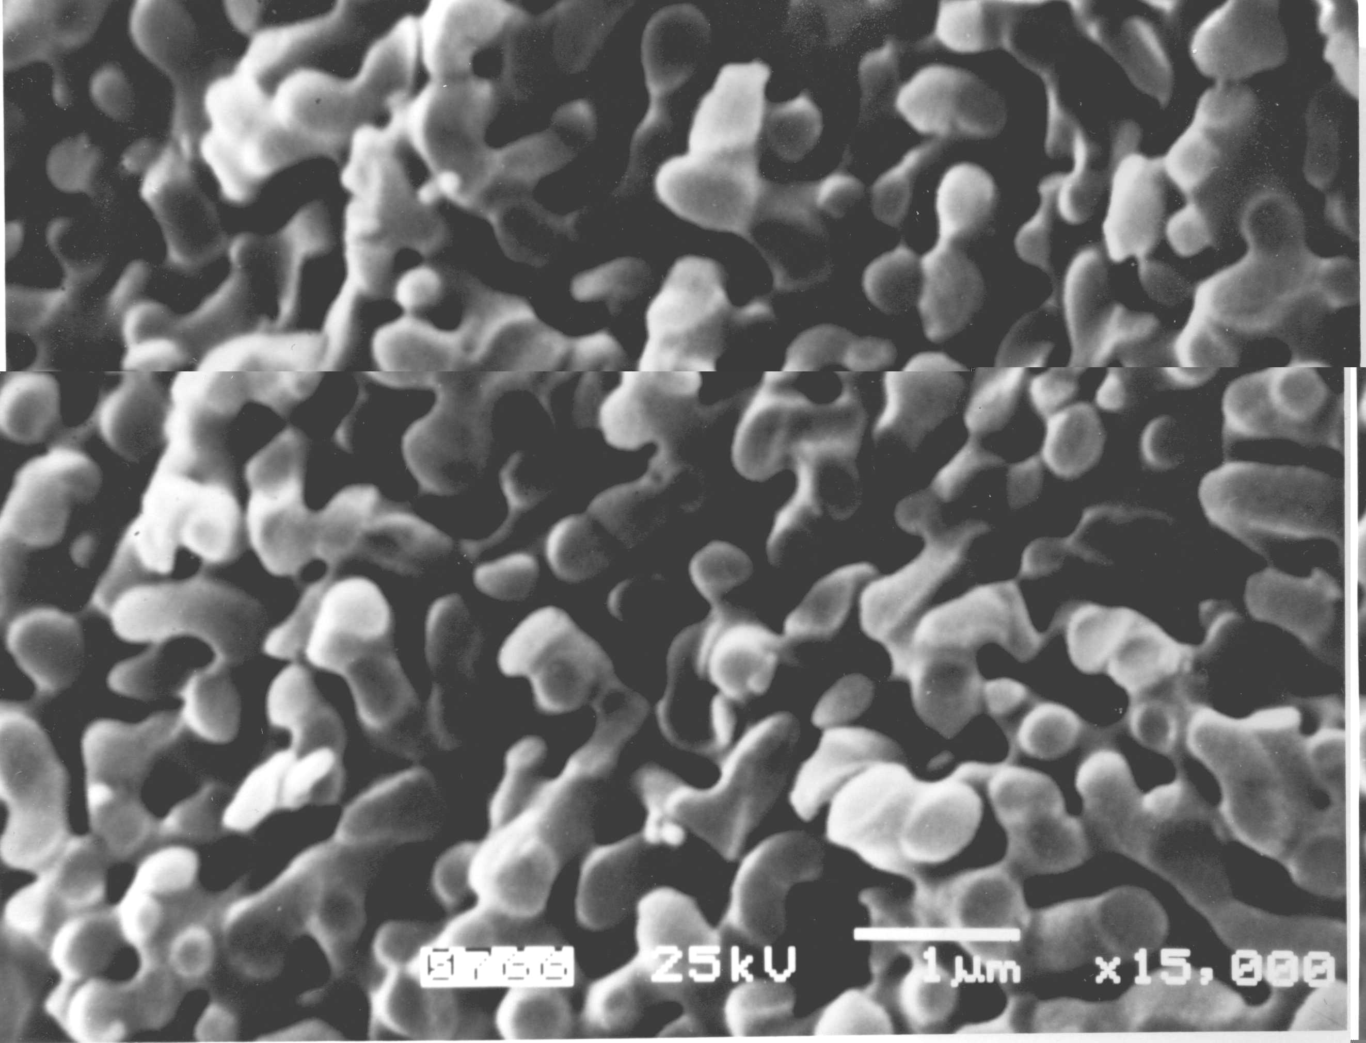
Porous borosilicate glass samples
Initial sodium borosilicate glass of the following composition
(% by weight): 62.6% SiO₂, 30.4% B₂O₃, 7%Na₂O
heat treatment at 490⁰C for 165h
heat treatment at 650⁰C for 100h
immersion in deionised water
Sample A
0.5N HCL
Sample C
rinsing in deionized water
drying at 200⁰C
additional treatment in 0.5N KOH
rinsing in deionized water
Sample B
drying at 200⁰C
Sample D

Slide 3
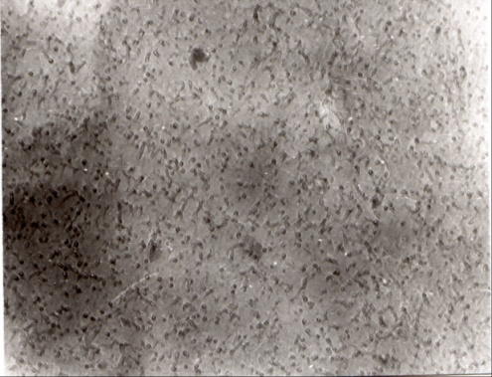
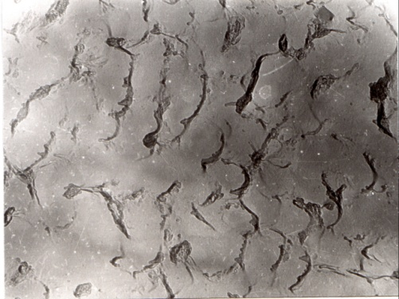
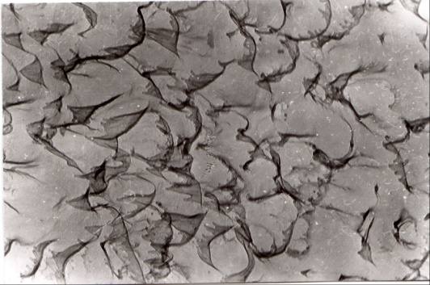
Commercial alkali borosilicate glass DV1 of the following composition (mol.%): 7% Na₂O, 23% B₂O₃, 70% SiO₂
bithermal heat treatment treatment at 650 ⁰C and at 530 ⁰C
thermal treatment at 530⁰C
immersion in deionised water
3M HCL
Sample I
Sample III
rinsing in deionized water
drying
Sample II
additional treatment in 0.5M KOH
rinsing in deionized water
drying

Slide 4
Structure parameters and water content

Slide 5
Dielectric response of the porous glass materials
Sample C
3
Sample C after heating
1

Slide 6
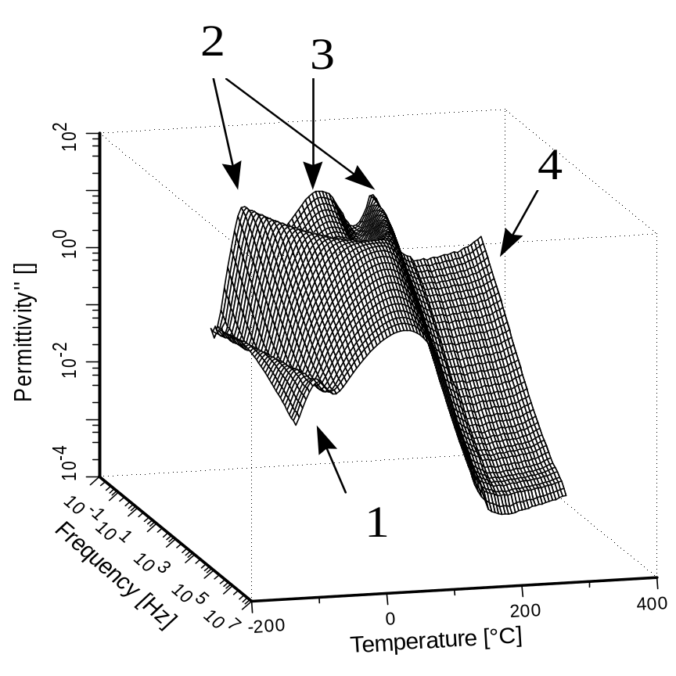
3-D PLOTS OF THE DIELECTRIC LOSSES FOR THE POROUS GLASS MATERIALS
Sample C
Sample II

Slide 7
Low frequency behaviour ~20 Hz
Β
Β
C
Α
C
Α
High frequency behaviour ~ 100 kHz

Slide 8
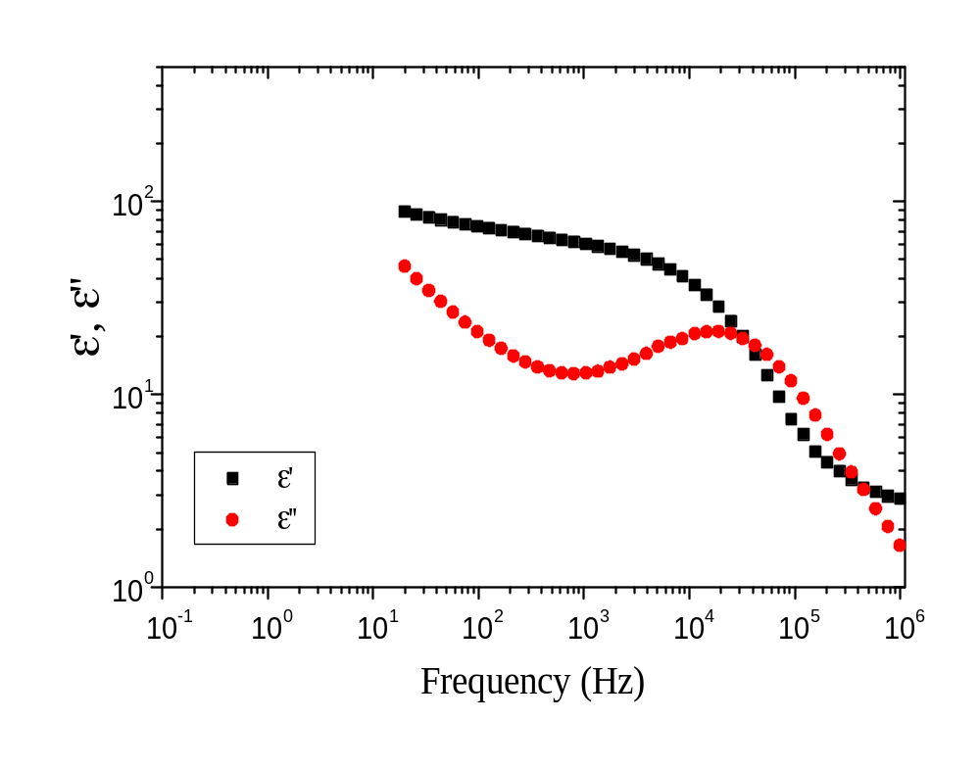
The fitting model
Conductivity
1)
ε*(ω ) = -iσ₀/ε₀ω
2
1
Jonscher
ε*(ω ) = B*ω ^{n-1}, ω τ >> 1
2)
Havriliak-Negami
ε*(ω ) = Δε / [1 + ( iω τ )^{α} ]^{β} + ε∝

Slide 9
1st Process
A - 50 kJ/mol B - 42 kJ/mol
C - 67 kJ/mol D - 19 kJ/mol
Ice - 60 kJ/mol
I - 64 kJ/mol II - 36 kJ/mol
III - 61 kJ/mol
Ice - 60 kJ/mol

Slide 10
Dependence of the Cole-Cole parameter α from ln(τ)
Humidity
h
,
Samples
%
II
0
.
63
A
1
.
2
B
1
.
4
D
1
.
6
C
3
.
2
III
3
.
39
I
3
.
6

Slide 11
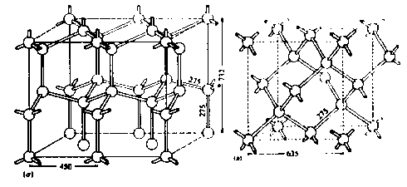
Temperature dependence of the dielectric strength

Slide 12
Parallel and anti-parallel
orientation
Orientation of the relaxing dipole units
parallel
non-correlated system
anti-parallel
B(T)
Temperature

Slide 13
The symmetric broadening of dielectric spectra
The Empirical Cole-Cole law (1941 )
τ
τ is the relaxation time
?
Character of
interaction
α
is a phenomenological parameter
Structure
Temperature
?
(1-α) π / 2
etc
Δε is the dielectric strength
13
Notes:
Добавить Δε

Slide 14
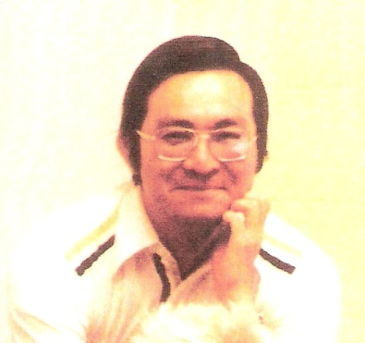
N. Shinyashiki, S. Yagihara, I. Arita, S. Mashimo, JPCB,102 (1998) p. 3249
What is behind the relationship α(τ)?
How can we use experimental knowledge about α and τ ?
For instance does their temperature or concentration dependencies explain the nature of dipole matrix interactions in complex systems?

Slide 15
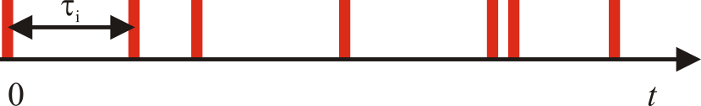
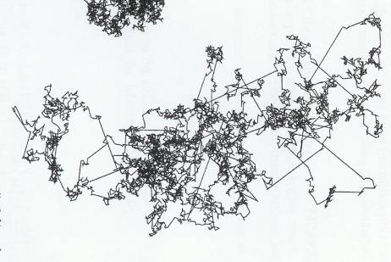
Anomalous Diffusion
The Traditional Theoretical Models
R.Metzler, J. Klafter, Physics Reports, 339 (2000) 1-77
W.T. Coffey, J. Mol. Liq. 114 (2004) 5-25
R.Hilfer , Phisica A, 329 (2003) 35-40
Fractional Cole-Cole equation
for relaxation function f(t)‏
Continuous time random walk (CTRW) model.
Levy flights
Dipole-Matrix interactions
The random Energy Landscape
Fractal set
r
Due to space averaging both space and time fractal properties are incorporated in parameters α .

Slide 16
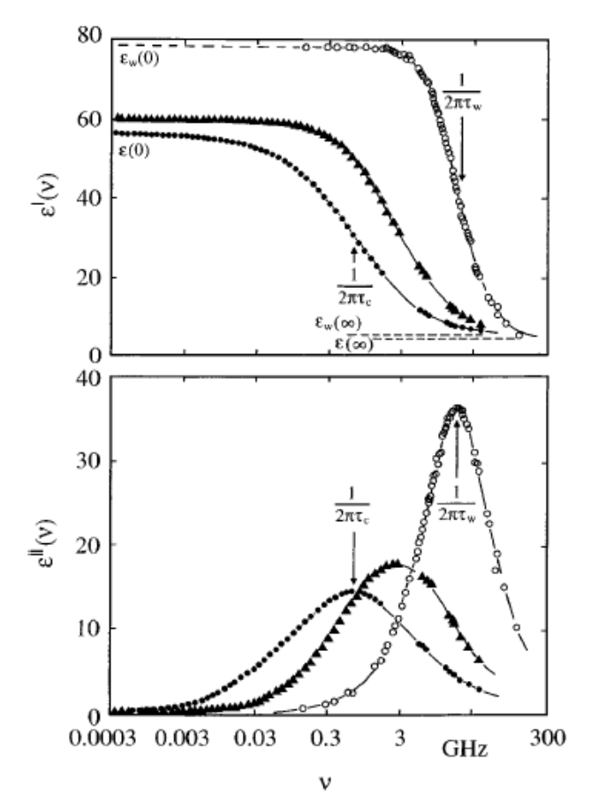
Dipole-matrix interaction
The symmetric broadening of dielectric spectra
Fractal set
Ryabov et al J. Chem. Phys. 116 (2002) 8611.

Slide 17
Scaling relations
τ is the macroscopic relaxation time
All dependences for different CS can be described
by Universal function
τ ₀ is the cutoff relaxation time
τ<τ₀
τ>τ₀
N is the average number of relaxation acts in the time interval t= τ
- fractal dimension of the relaxation acts in time
α, τ and N depends on temperature, concentration, etc
If
is a monotonic function
is a minimum number of relaxation acts
A is the asymptotic value of fractal dimension not dependent on temperature

Slide 18
Sample C
Sample | Porous Size, nm | Specific porous area, m²/g | Porosity% | H,%
C | 280-400 | 9.880 | 38 | 3.2
Rich water content
During the time of 1 ps, 70 relaxation acts occurs.
τ>τ₀
0
τ₀
τ
t
The density of the relaxation acts on the time interval τ
A≈0.19 is the fractal dimension of the time set of interactions
The total number of the relaxation acts during the time τ

Slide 19
Sample D
Sample | Porous Size, nm | Specific porous area, m²/g | Porosity% | H,%
D | 300 | 8.74 | 50 | 1.2
Poor water content
τ<τ₀
A=0.495
τ < τ₀
τ₀
0
τ₀
τ
t
0
t
τ

Slide 20
Kirkwood-Froehlich approach
How can we link the numbers of the relaxation acts in time and the molecular structure, in which they occurred ?
Additional parameters should be considered :
which can be incorporated by using the Kirkwood-Froehlich approach
Orientation of the relaxing dipole units
is the average dipole moment of the i -th cell
parallel
anti-parallel
<…> indicate a statistical averaging over all possible configurations.
non-correlated system
B
Θ is the angle between the dipole moment of a given cell and neighboring ones,
N_{n} is the number of the nearest cell dipoles.
Temperature

Slide 21
Sample C
For water molecules in porous glasses
θ is the angle between the dipole moment
of a given cell and neighboring ones,
N_{n} is the number of the nearest cell dipoles.
T_{m}≅195 K
The maximum conditions:
reflect the system state with balanced parallel and anti parallel dipole orientations . The corresponding values of parameters are :
The effective number of the correlated water molecules is

Slide 22
Sample C:l The kinetic and structural properties
Anomalous sub-diffusion
Arrhenius temperature dependence
The CC relaxation process is associated with the anomalous sub-diffusion.
R. Metzler and J. Klafter, Phys. Rep., 339,1(2000).
R. Hilfer, Applications of Fractional Calculus in Physics,
Ed. By R. Hilfer ,(World Scientific, Singapore,2000).
is a monotonically decreasing function of temperature throughout the temperature range
The time-space scaling relationship
An anti parallel orientation of the cell dipoles, m, is stipulated by the influence of the porous matrix interface
Two main scales of cluster in the Ice-like layer on the matrix interface
L² is the macroscopic scale of the matrix interface area
At T<<T_{m}
l
l ² is the area of the mesoscopic scale of the Kirkwood-Froehlich elementary unit with an average dipole moment m
L

Slide 23
Sample C: Coupling the kinetic and structural properties
The parallel orientation of the cell dipoles, m, is stipulated by the influence of the external layers of the water molecules
At T >> T_{m}

Slide 24
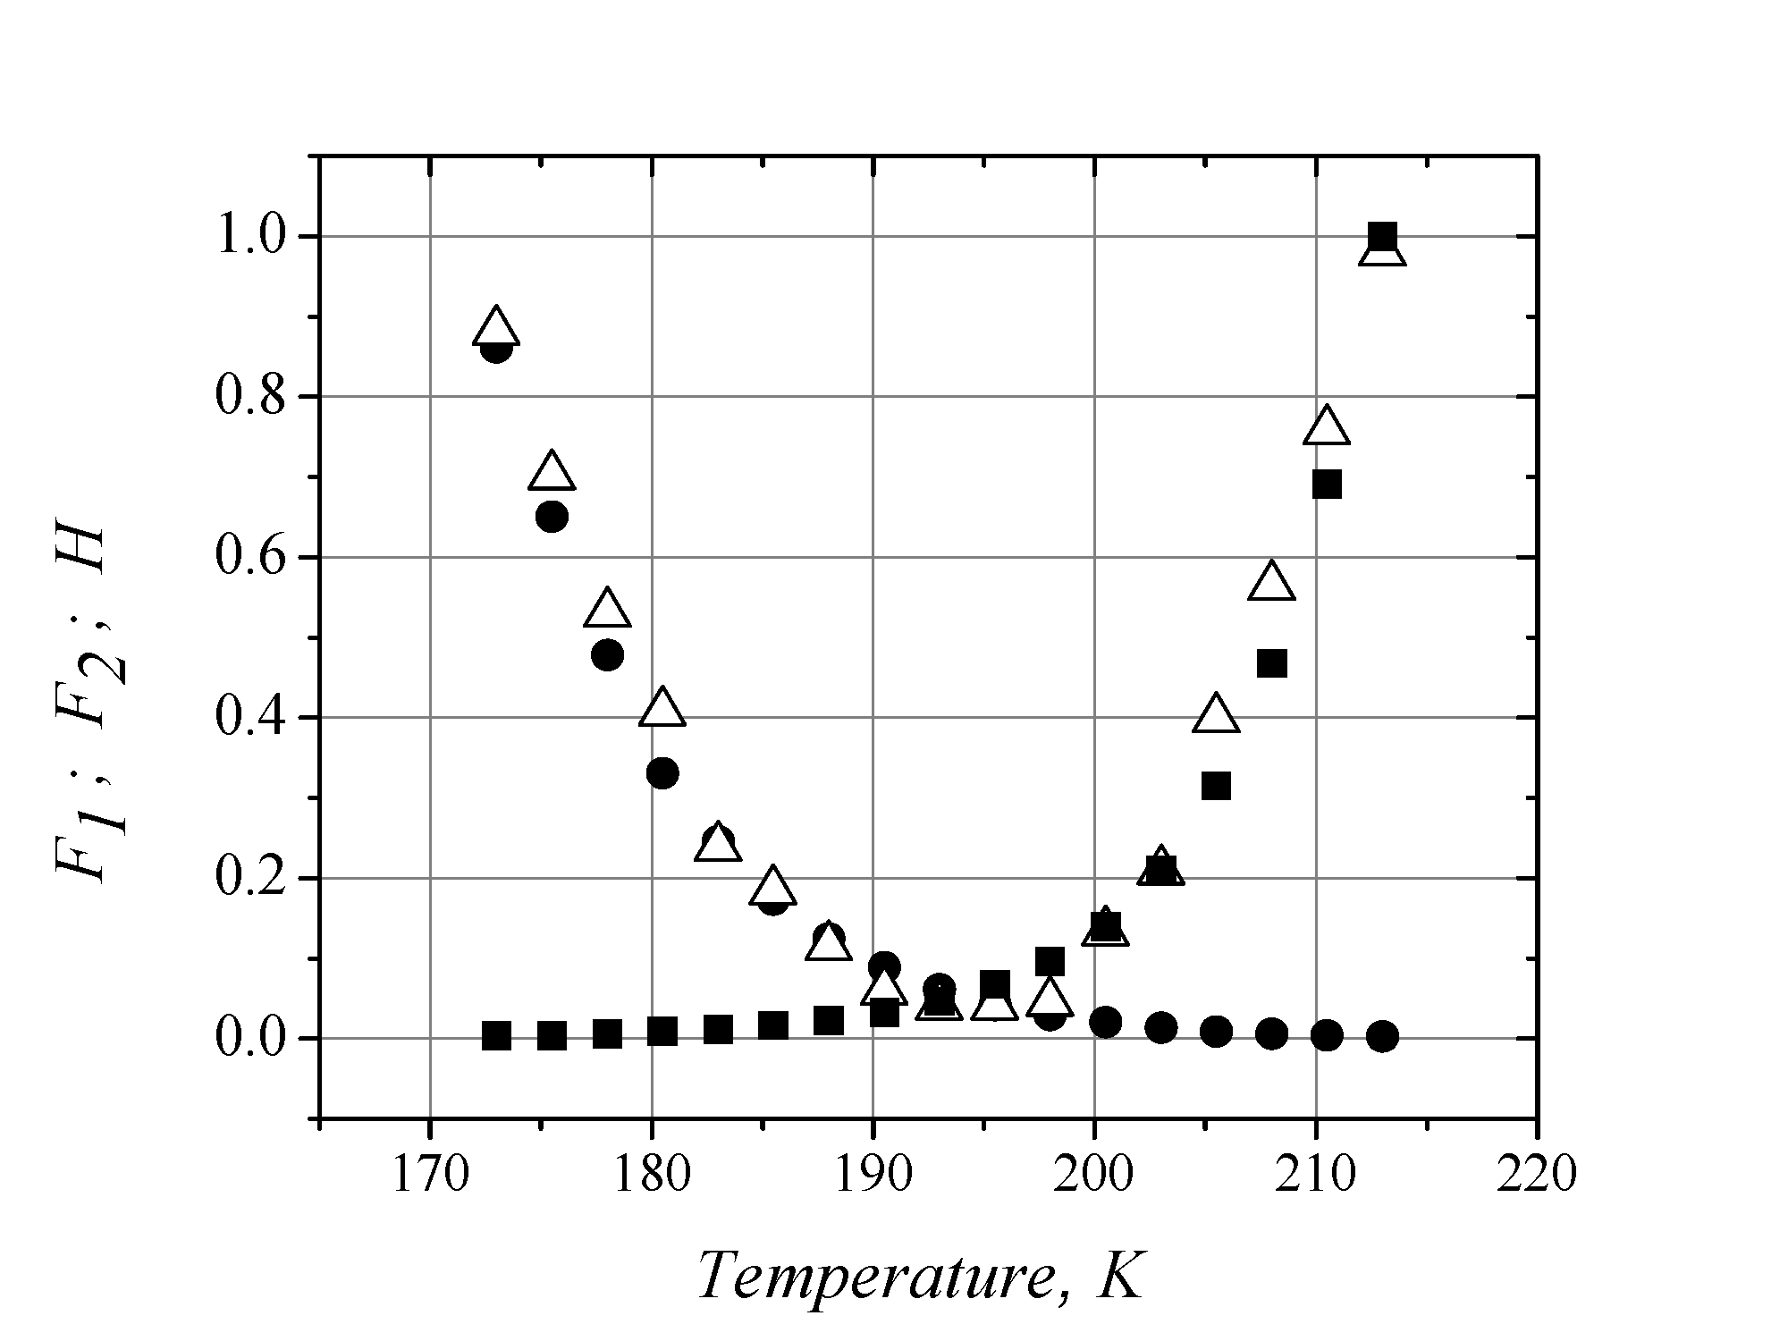
T_{m} = 195K
R
The Kirqwood-Froehlich cell
R
L
L
- H
- F₁
- F₂

Slide 25
Second Process
2

Slide 26
Orientation Defect
D-defect
L -defect
Si
Si
Si
O
O
O
V* is the defect effective volume
V_{f} is the mean free volume for one defect
N is the number of defects in the volume of system V
, where

Slide 27
The fitting results for the second process
ΔH_{a} is the activation energy of the reorientation
ΔH_{d} is the activation energy of the defect formation
τ_{o} is the reorientation (libration) time of the restricted water molecule in the hydrated cluster
η is the maximum possible defect concentration

Slide 28
Dielectric relaxation in percolation
Percolation: Transfer of electric excitation through the developed system of open pores
Γ ( t /τ ) ~ e^{−( t /τ) ν} , D_{f} = 3ν,
where D_{f} is a fractal dimension
Notes:
2

Slide 30
Porous medium in terms of regular and random fractals
Λ
φ : porosity of two phase solid-pore system
V_{p} : volume of the whole empty space
V : whole volume of the sample
λ
Λ , λ : upper and lower limits of self-similarity
D : regular fractal dimension of the system
μ = λ / Λ
ξ : scale parameter ξ ∈ [μ,1]
w : size distribution function
α, β, A: empirical parameters

Slide 31
Porosity Determination
(A.Puzenko,et al., Phys. Rev. (B), 60, 14348, 1999)

Slide 32
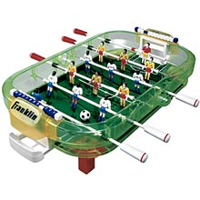
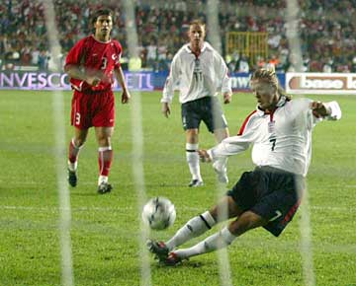
The transition associated with the formation of a continuous path spanning an arbitrarily large ("infinite") range.
The percolation cluster is a self-similar fractal.
Percolation
E
D
y
z
Q
C
B
Static condition of renormalization
x
O
O
A

